Slide 1
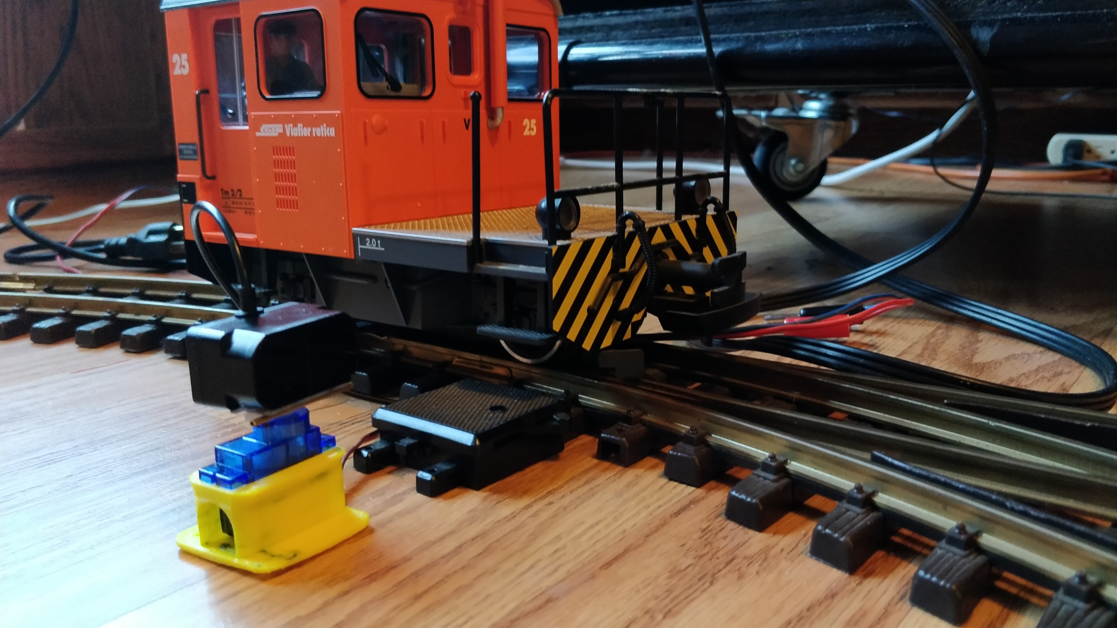
Software Defined
Block
Detector
with TF Mini Plus
(Experimenting with New Technologies)

Slide 2
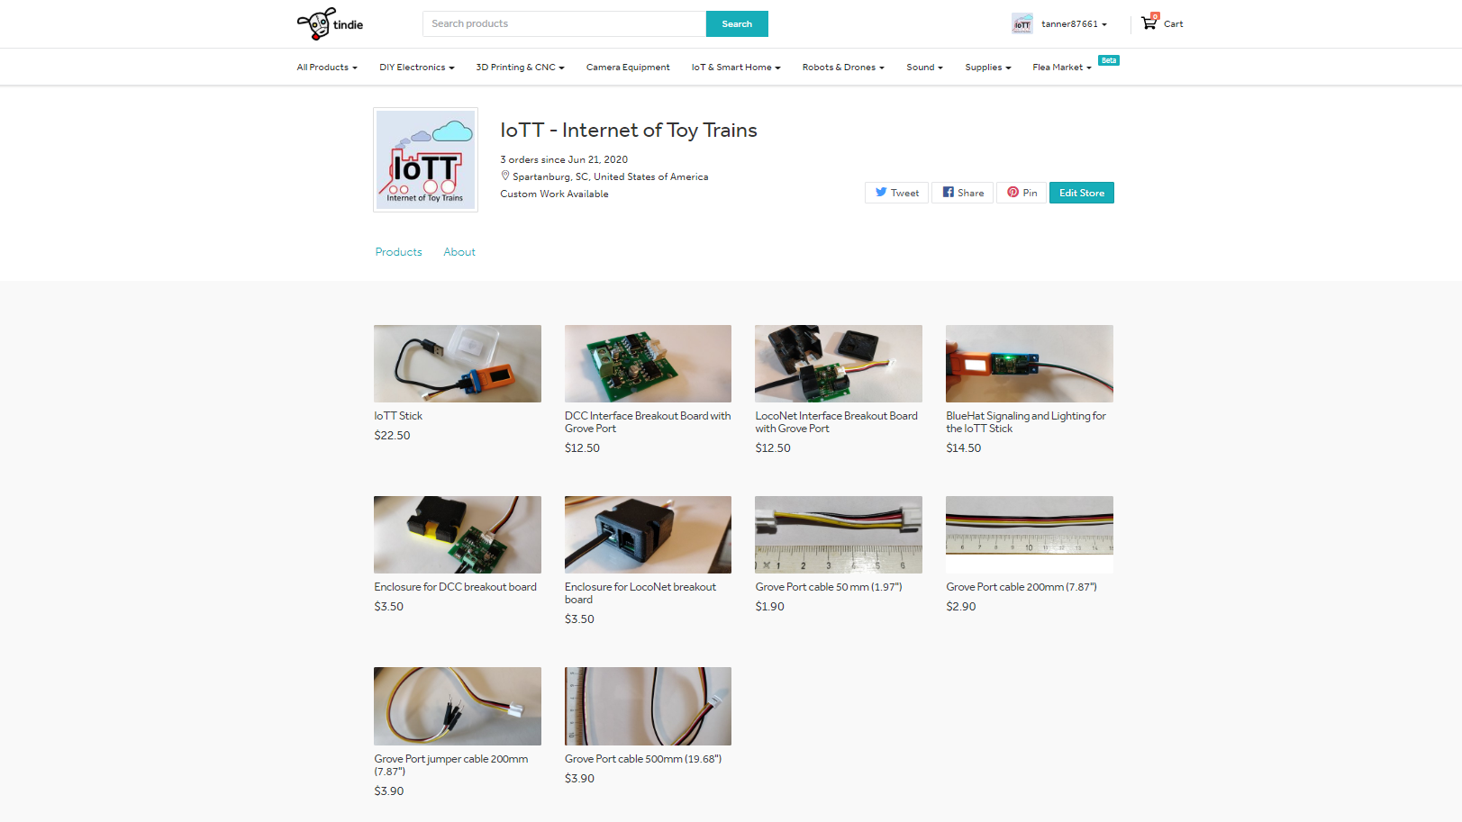


Slide 3
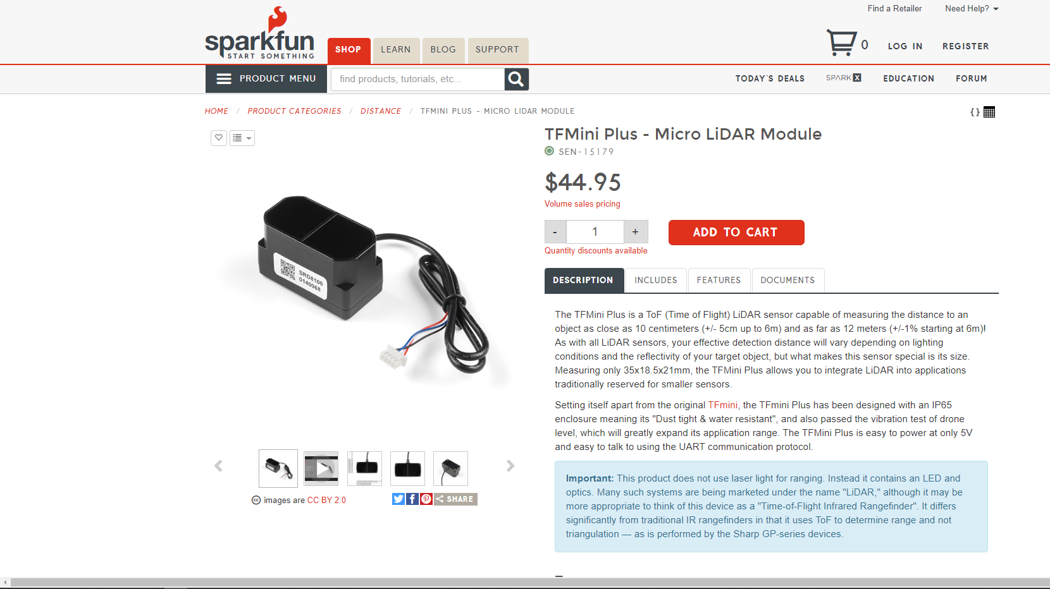

Slide 4


Slide 5
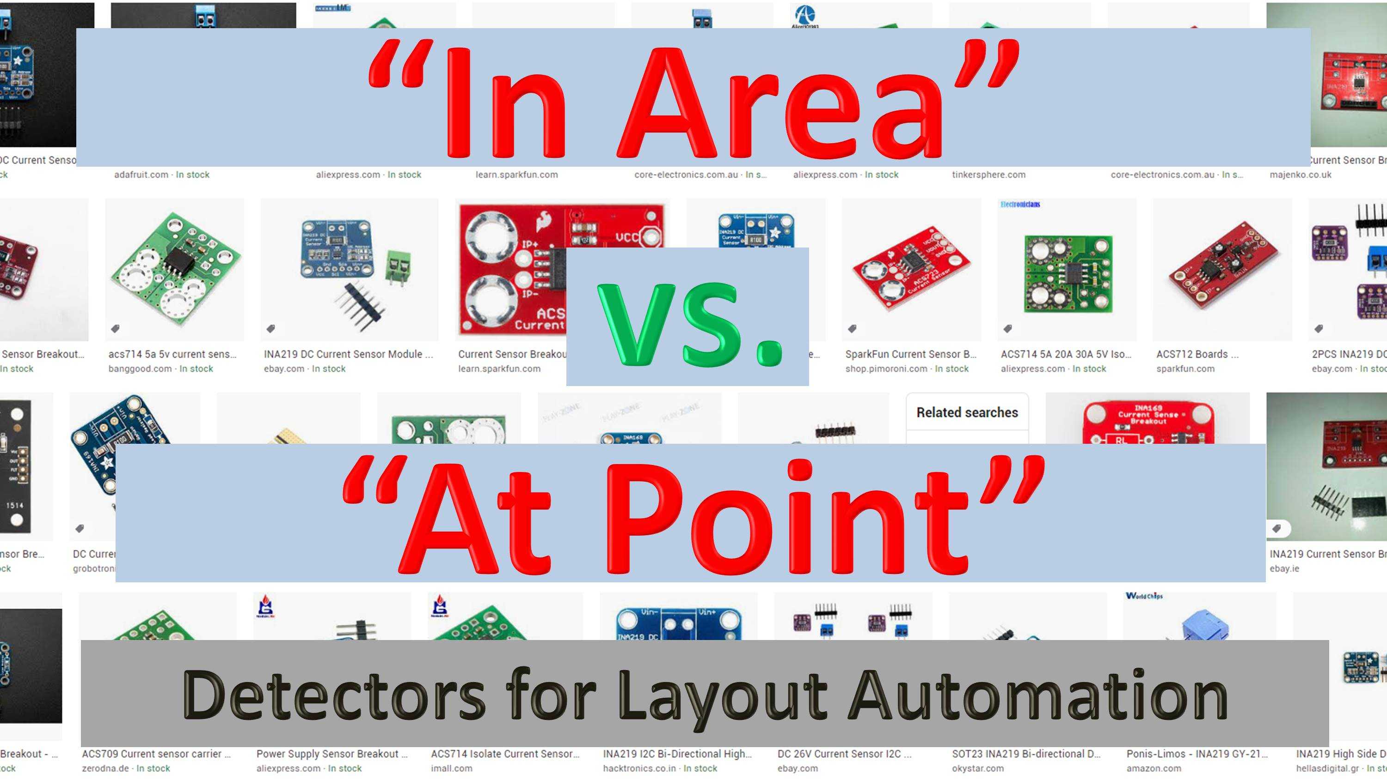

Slide 6


Slide 7

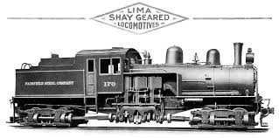

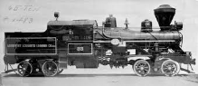
Shay
Track 1
Track 2
Heisler
I have a layout I take to shows that has a loop with a hidden passing track. While the rest of the layout is DCC, this is analog. Using reed switches and relays, I have a Shay that comes from behind trees and brings loaded log cars to the logging camp. After it disappears behind the camp, a Heisler brings empties back to the woods.

Slide 8
Shay
Track 1
Track 2
Heisler
Running analog, is simple. A reed switch at entry on track 1 closes a relay that sustains itself, and is a reversing switch to the loop. The trains go in opposite direction: the loaded one to the sawmill, the empties go from the mill back to the woods. A reed switch on track 2 releases the relay. A diode to each track stops the incoming train while the other train makes the trip. That all works beautifully, but I would like to do this with JMRI scripting.

Slide 9
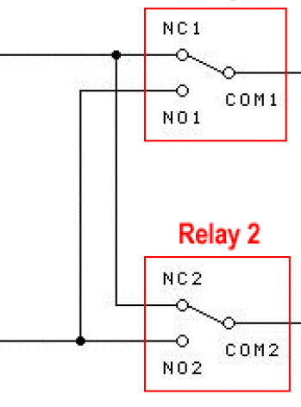
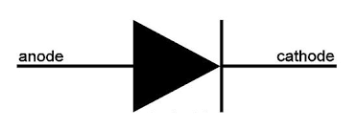
“At Point” Reed switch detectors activate polarity relay for one or the other direction: Arriving Shay starts Heisler and vice versa
Relay
Shay
Track 1
Rail A
Track 2
DC Power Supply
Heisler
Track 1
Isolated section only powered for one travel direction as diode blocks polarity for the other
Rail B
Track 2
Gap in Rail
Running analog, is simple. A reed switch at entry on track 1 closes a relay that sustains itself, and is a reversing switch to the loop. The trains go in opposite direction: the loaded one to the sawmill, the empties go from the mill back to the woods. A reed switch on track 2 releases the relay. A diode to each track stops the incoming train while the other train makes the trip. That all works beautifully, but I would like to do this with JMRI scripting.

Slide 10
Shay
Heisler

Slide 11
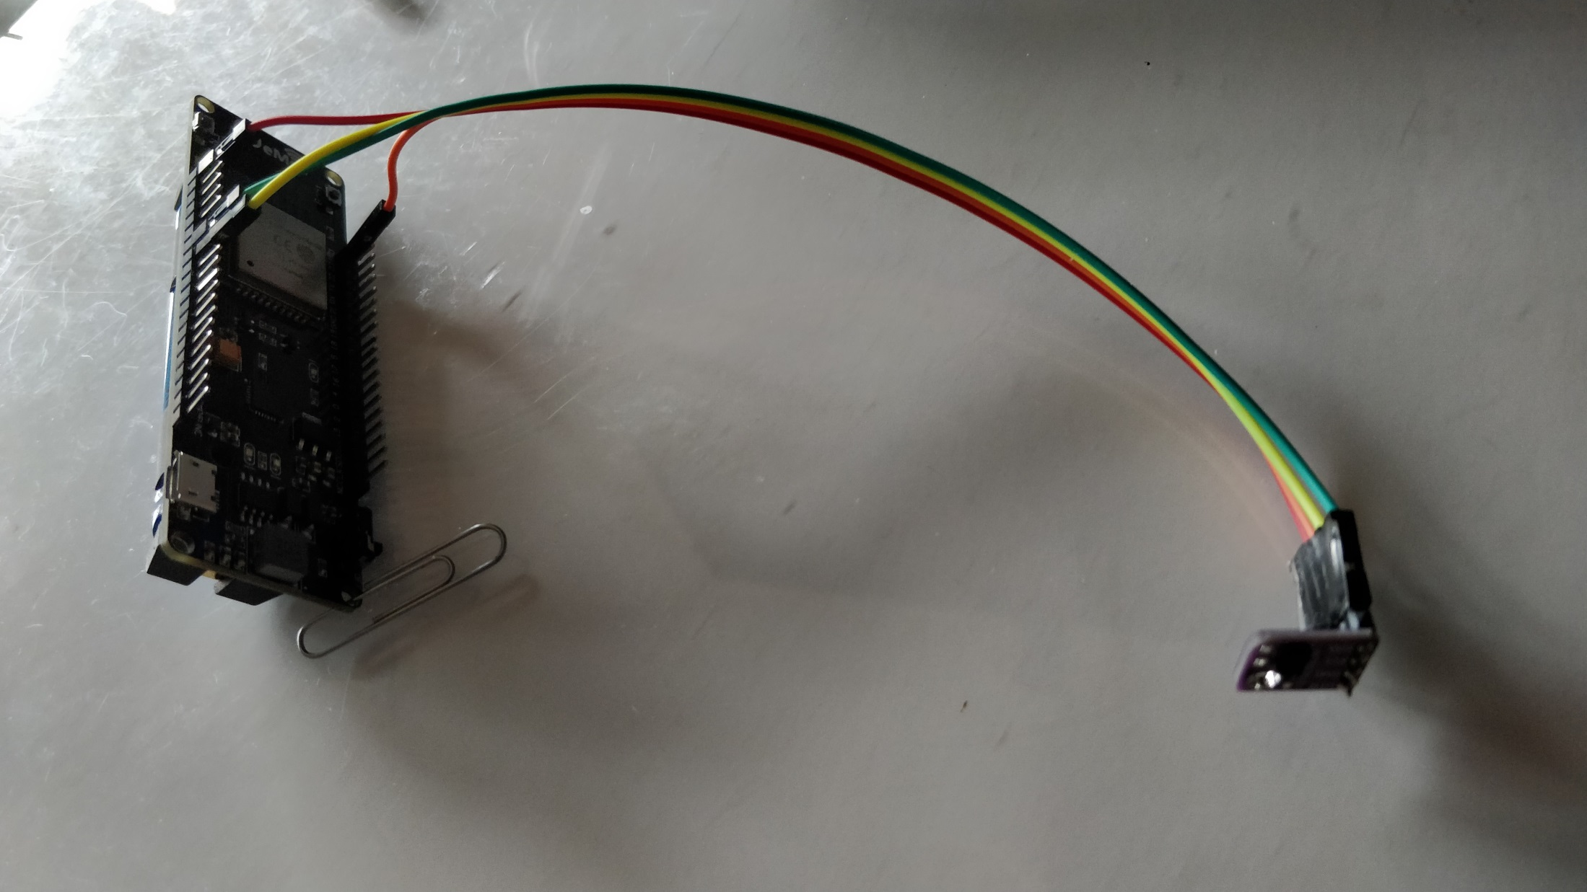
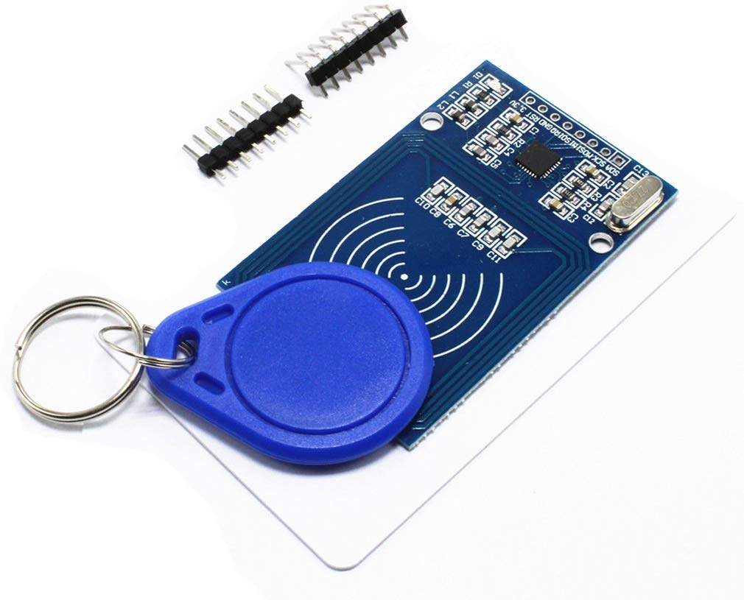
Hi Resolution
Block Detector II
with RFID
(Experimenting with New Technologies)

Slide 12
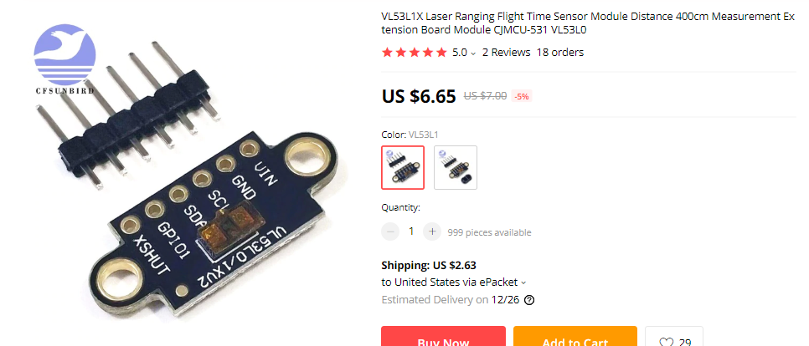

Slide 13
Looking for…
Reliable detection of a car or locomotive
No modification of the axles
Information available right after powering up the layout
Hi resolution
Providing the exact location of the train within the block

Slide 14
“At Point” detectors activate polarity relay for one or the other direction: Arriving Shay starts Heisler and vice versa
Relay
Shay
Track 1
Rail A
Track 2
DC Power Supply
Heisler
Rail B
Track 1
Track 2
Isolated section only powered for one travel direction as diode blocks polarity for the other
Gap in Rail

Slide 15
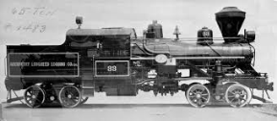
Shay
Track 1 Detection
Track 1
Track 2 Detection
Track 2
Software Defined Sensor
Heisler

Slide 16

MQTT
Broker
LocoNet over MQTT
ESP32 Wemos
Gateway
Wired LocoNet
Test
BlueBox
SPI Connection
I²C Connection
LED Strip
MFRC522
Sensor
VL53L1X
Sensor

Slide 17

Adjustable Sensor Plate
Sensor Detection Area (Active Cone)
10°
Sensor
Detected and measured as Loco reflects the beam well
Undetected as Loco echo is too weak to be detected

Slide 18
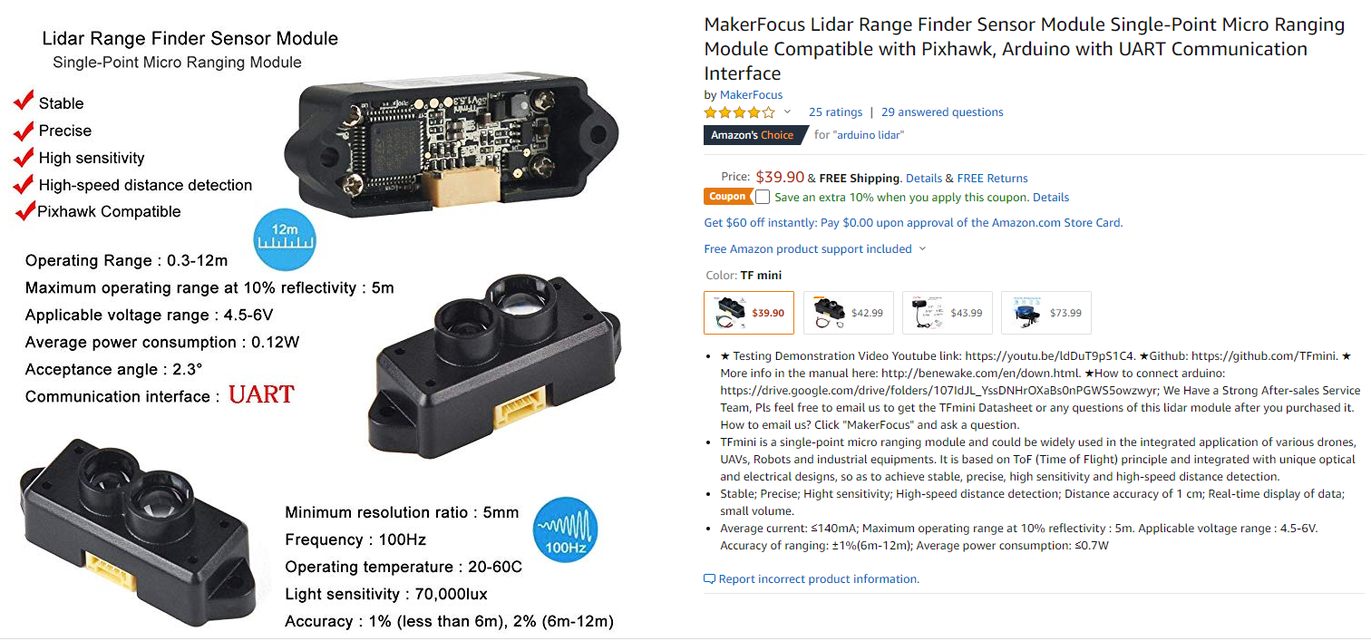

Slide 19
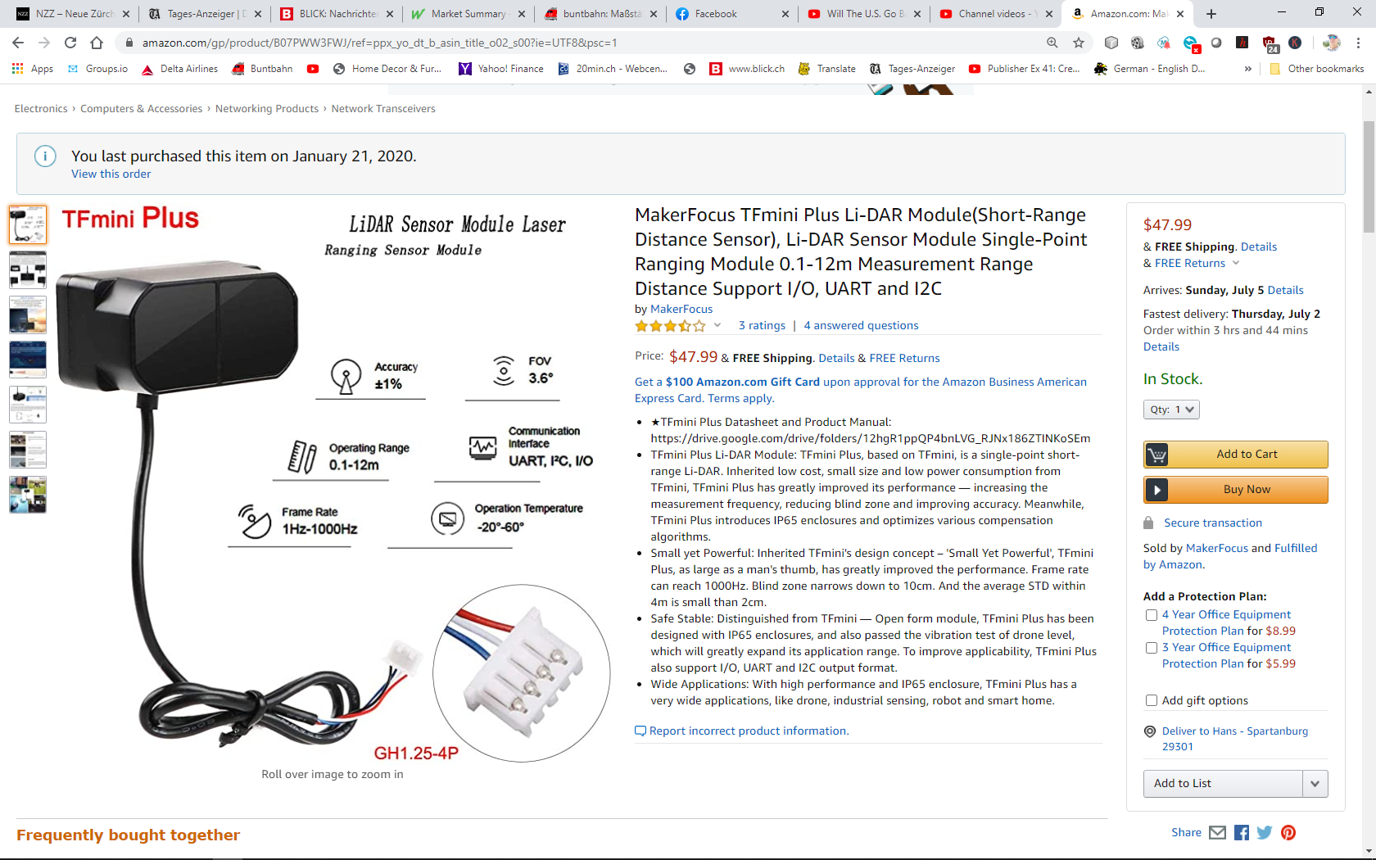

Slide 21
Shay
Track 1
Track 2
Heisler

Slide 22
Relay
Shay
Track 1
Rail A
Track 2
DC Power Supply
Heisler
Rail B

Slide 23
Relay
Shay
Track 1
Rail A
Track 2
DC Power Supply
Heisler
Rail B
Track 1
Track 2
Isolated section only powered for one travel direction as diode blocks polarity for the other
Gap in Rail

Slide 24
“At Point” detectors activate polarity relay for one or the other direction: Arriving Shay starts Heisler and vice versa
Relay
Shay
Track 1
Rail A
Track 2
DC Power Supply
Heisler
Rail B
Track 1
Track 2
Isolated section only powered for one travel direction as diode blocks polarity for the other
Gap in Rail

Slide 25
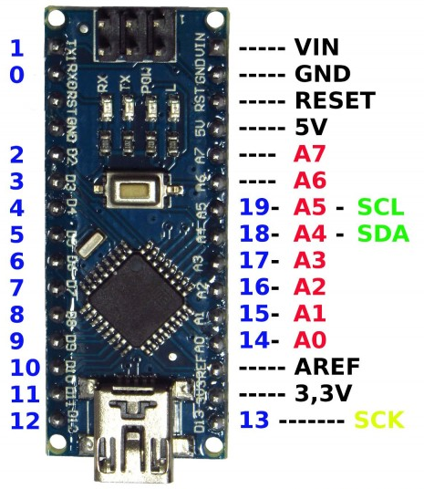

Slide 27
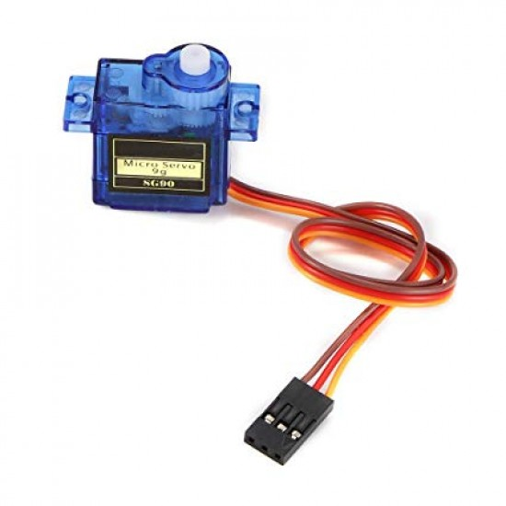

Slide 28
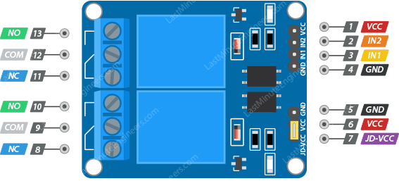

Slide 29
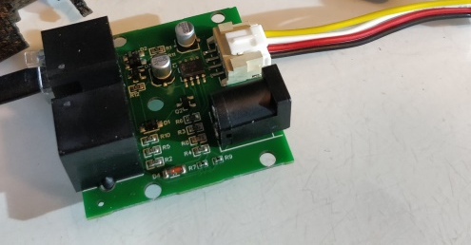

Slide 30
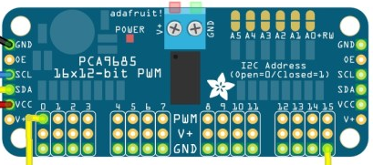

Slide 31
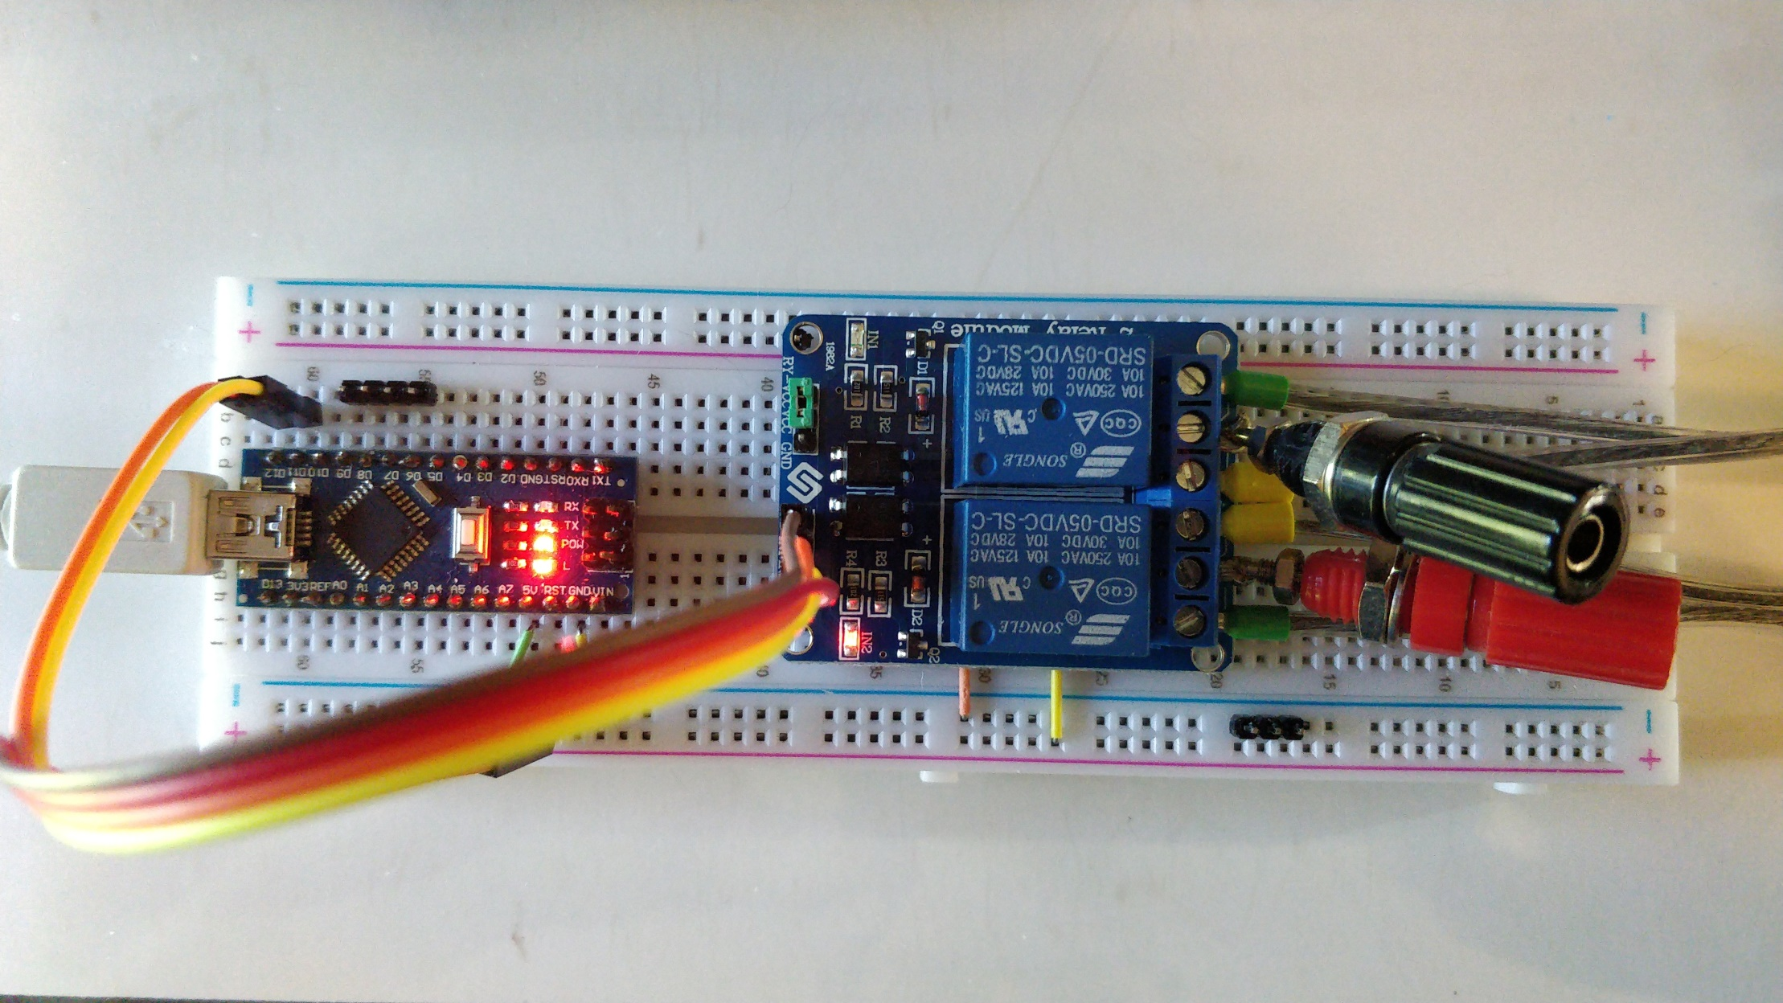
Relay inputs connected to IO Pins 11 and 12 …
…and DC input and track receptacles on the output

Slide 32
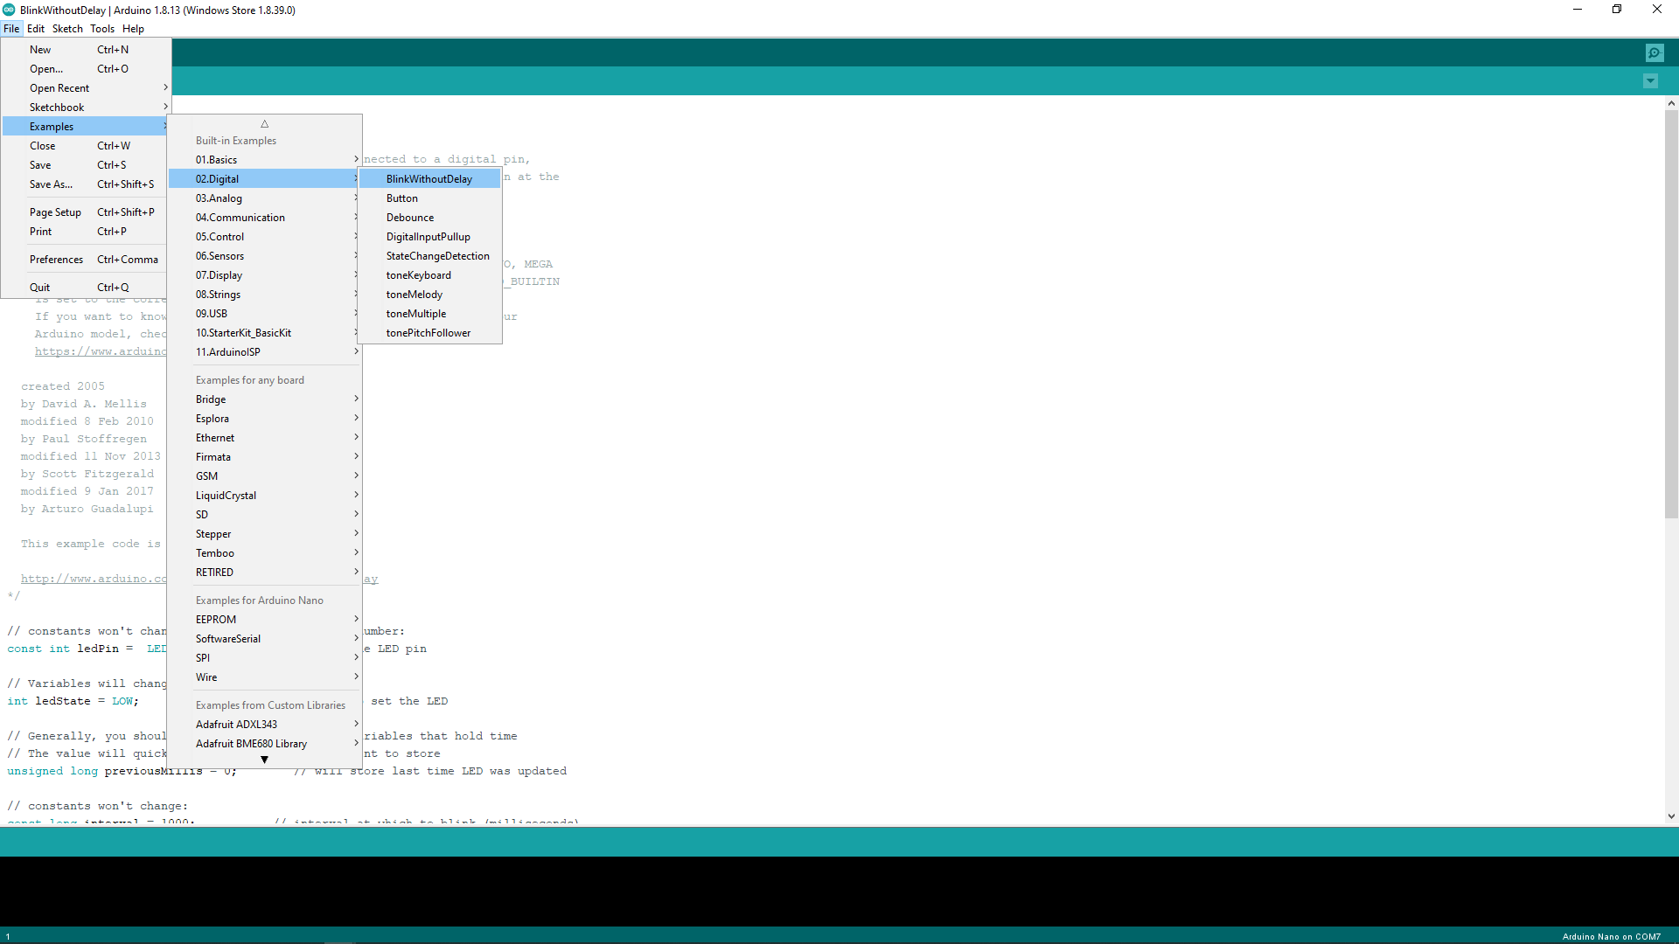

Slide 33
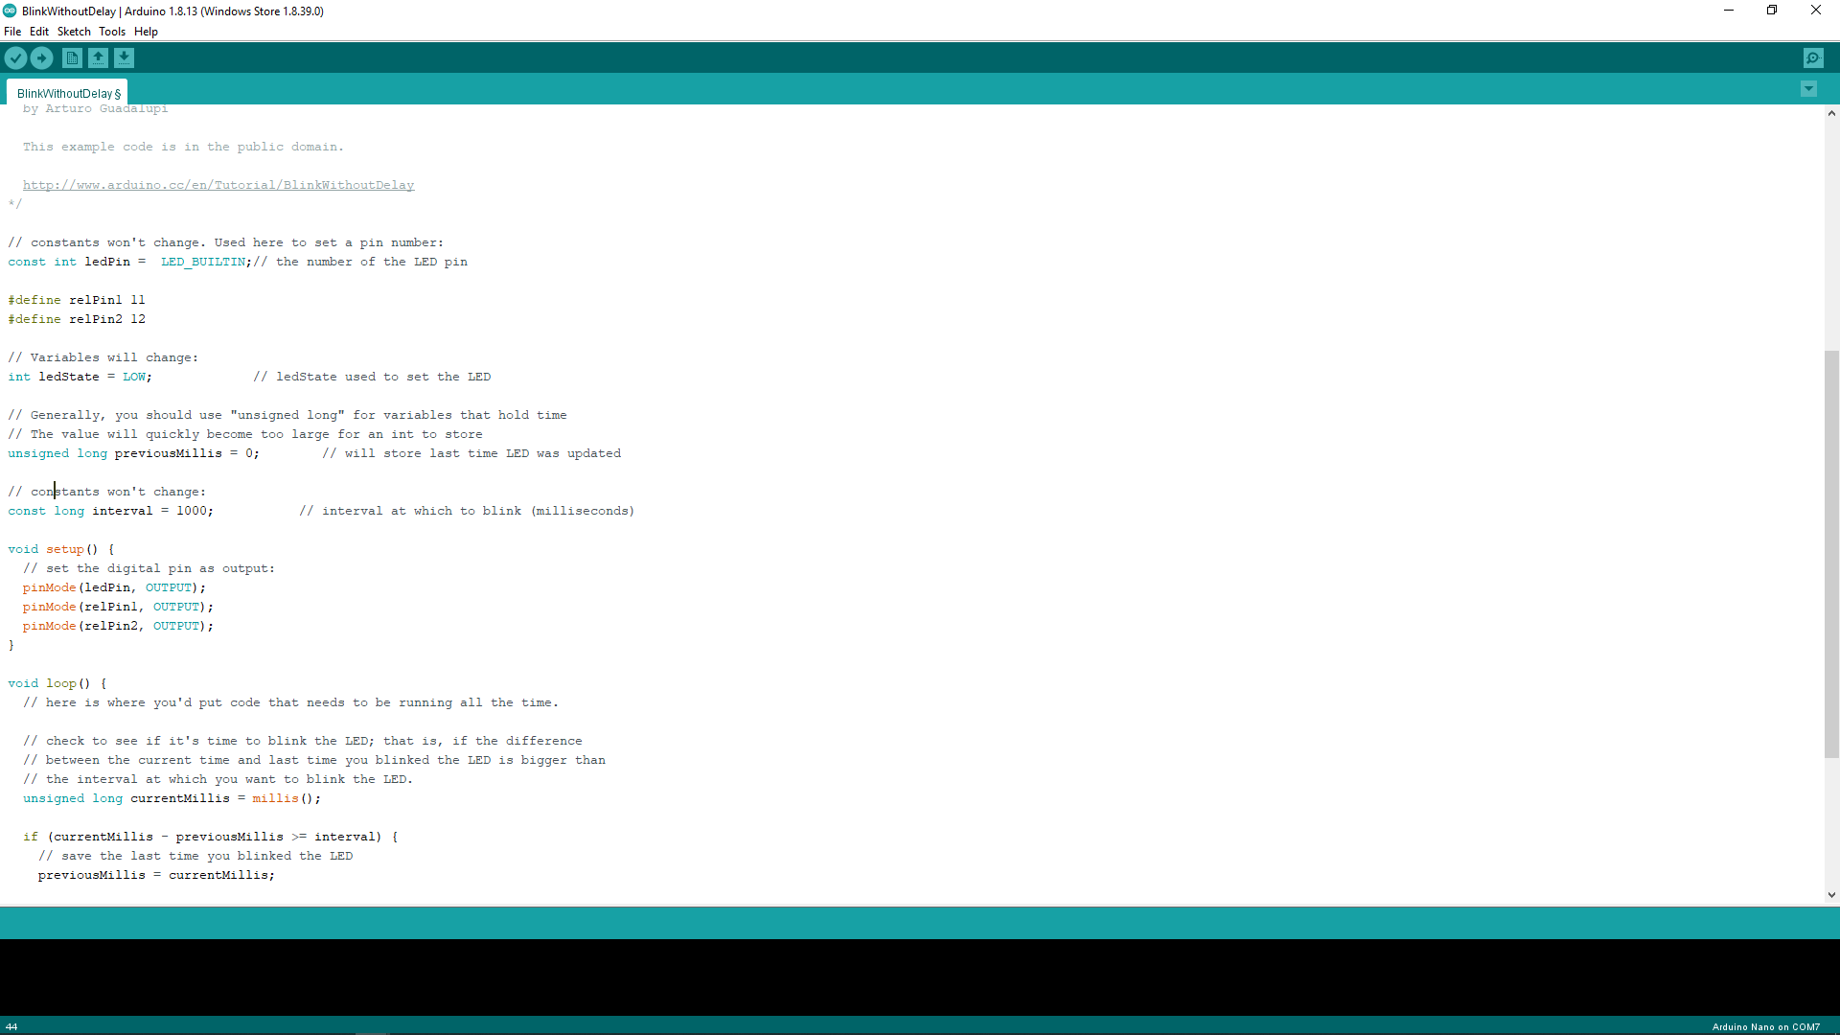

Slide 34
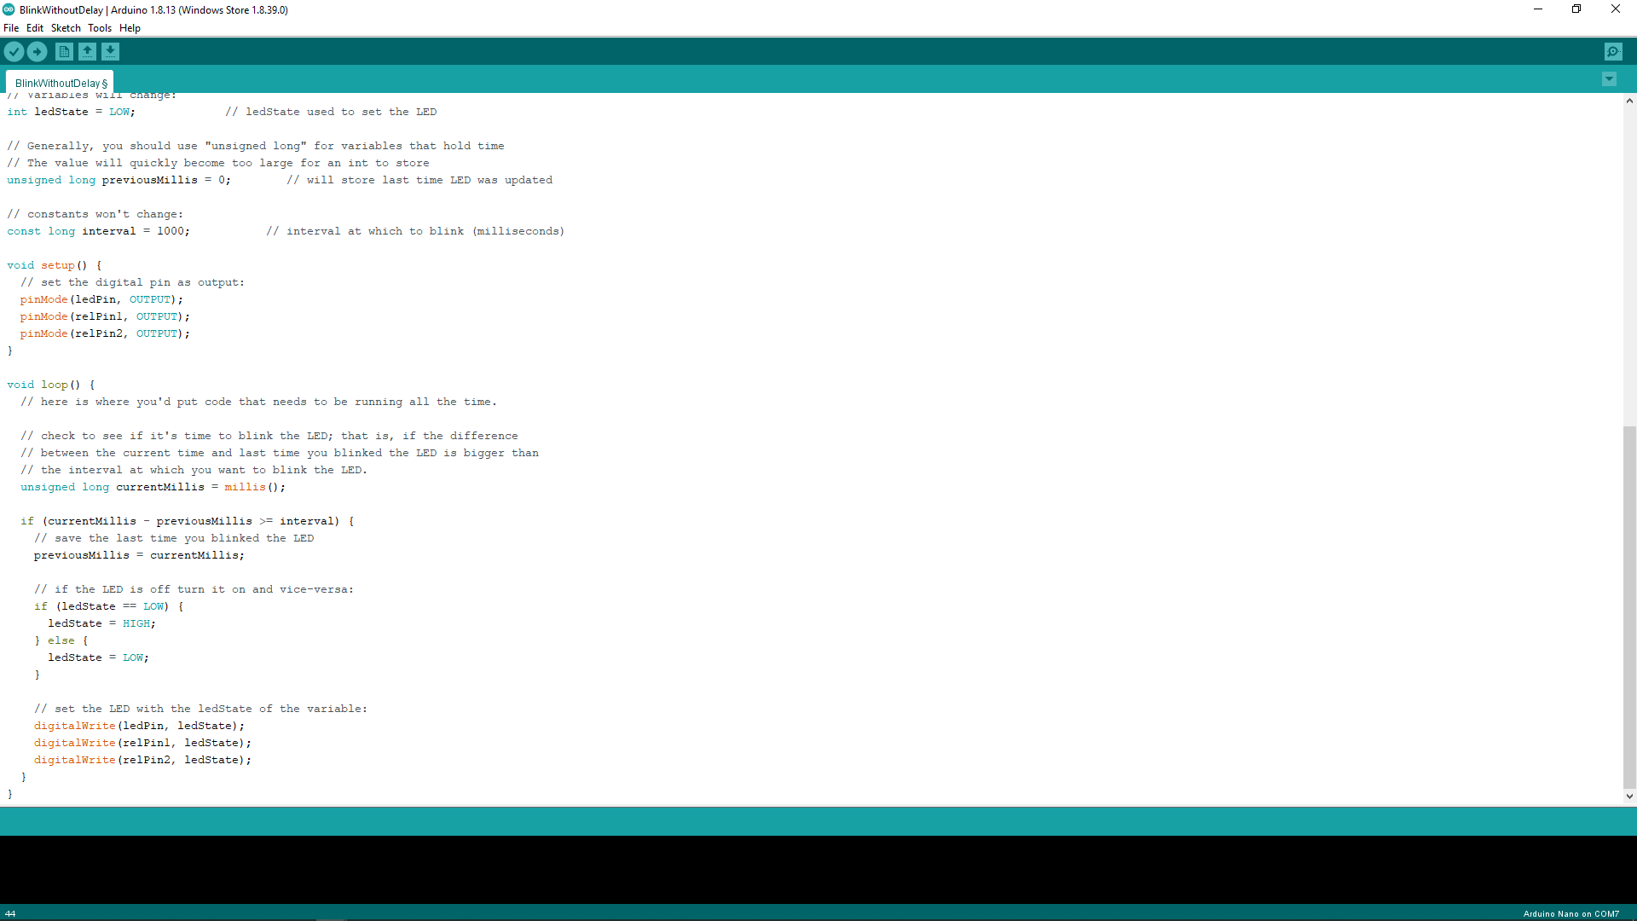

Slide 36
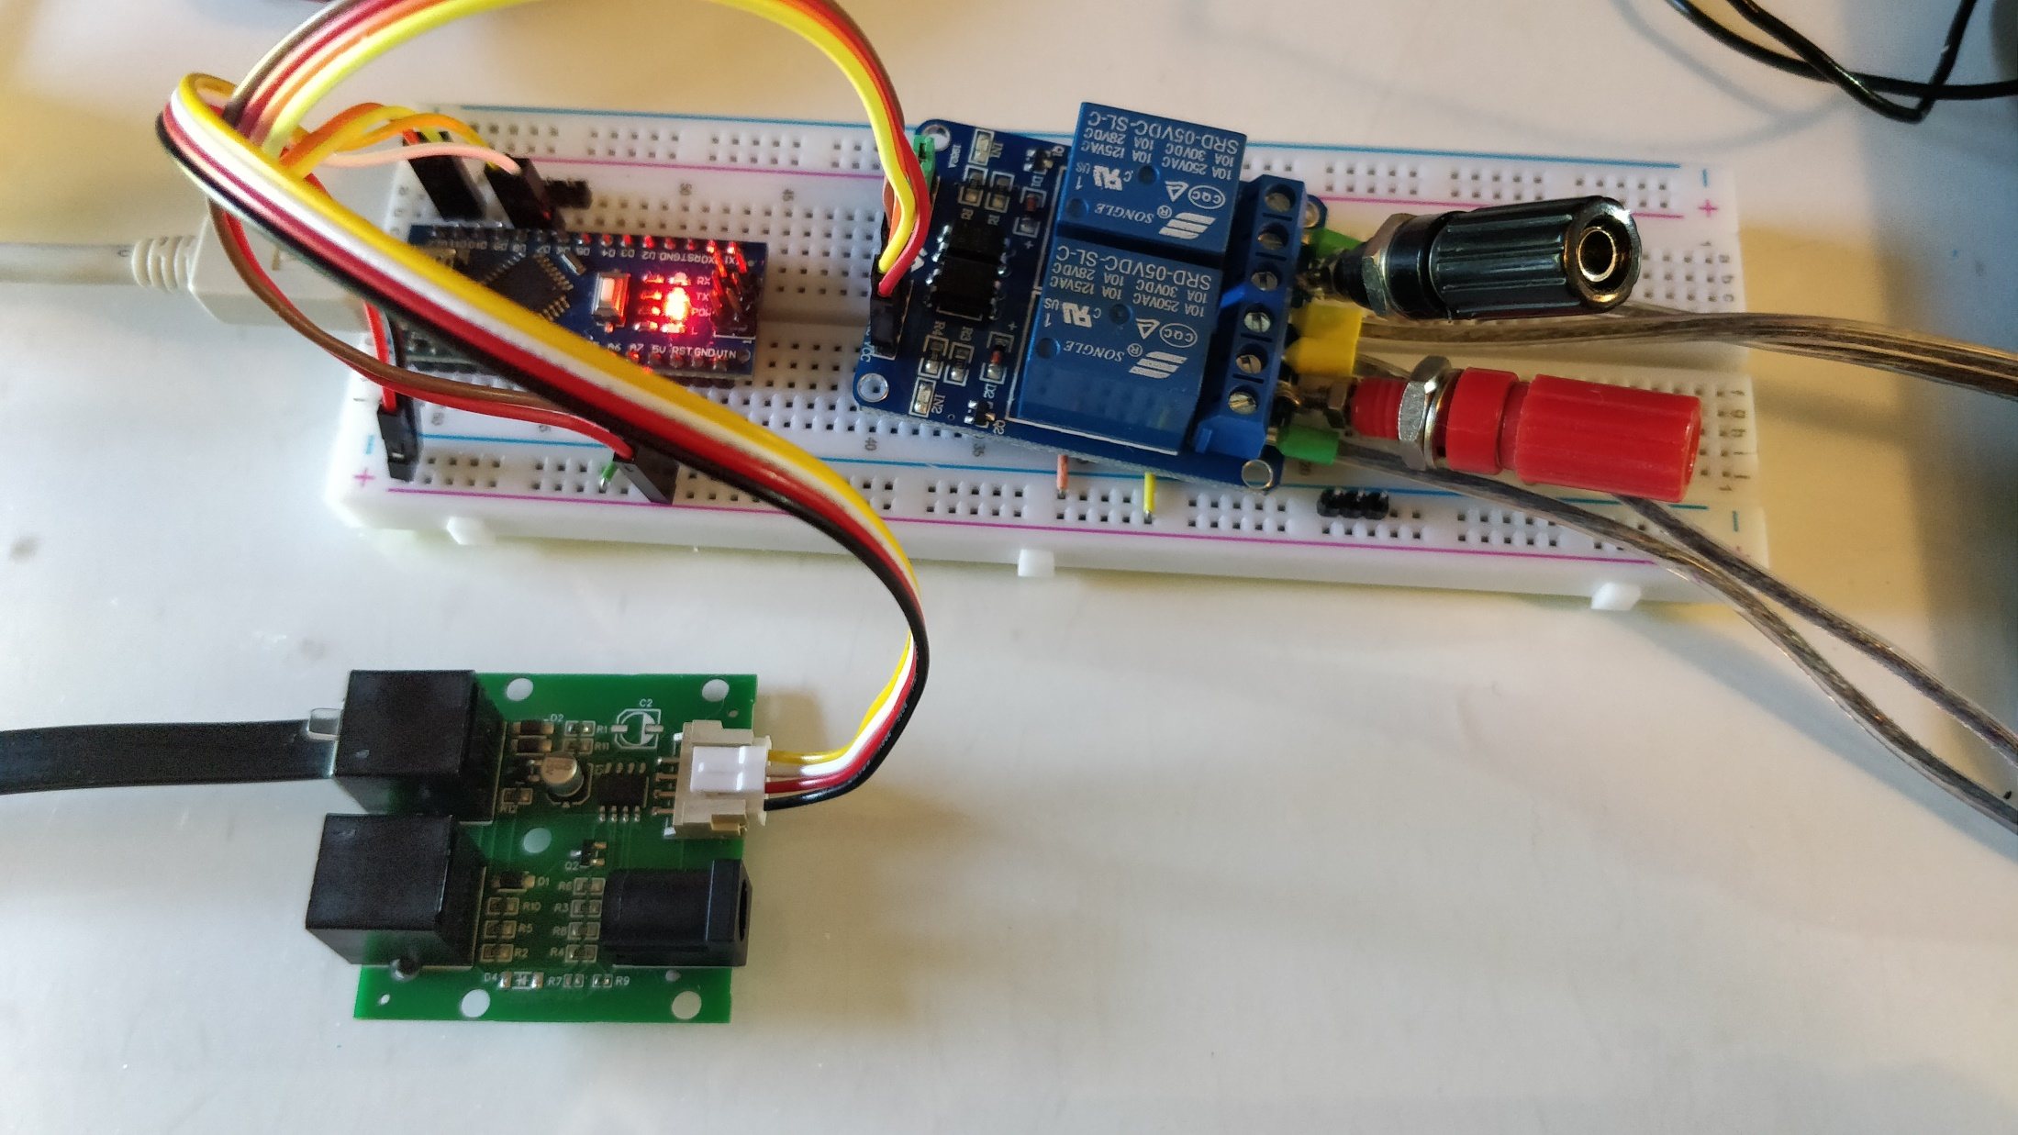
LocoNet Interface Breakout board to IO pins 7 (Tx) and 8 (Rx) using jumper wire
Note: Modify Interface board for 5V signal level of Nano

Slide 37
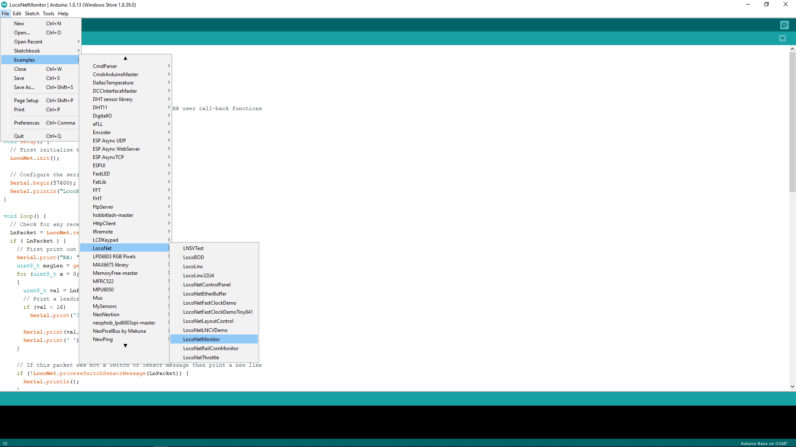

Slide 38
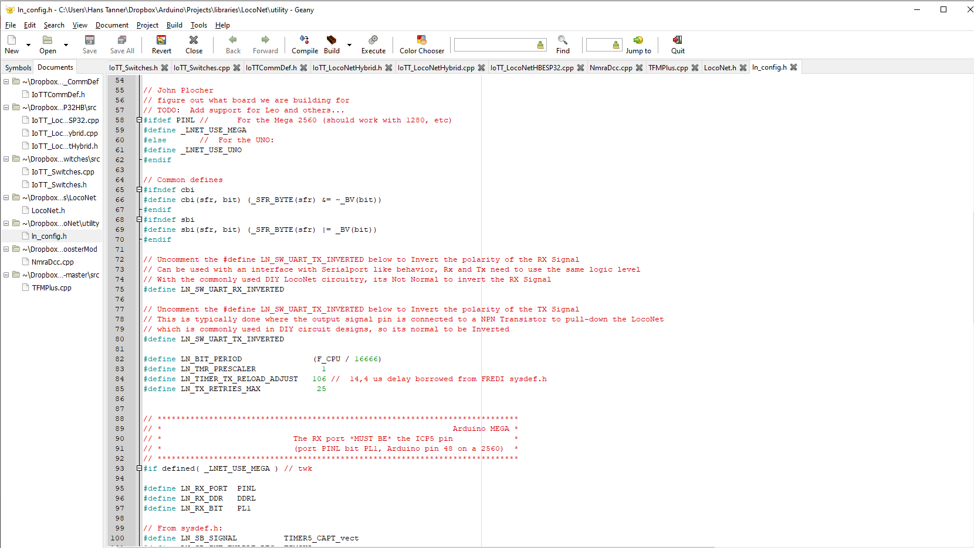

Slide 39
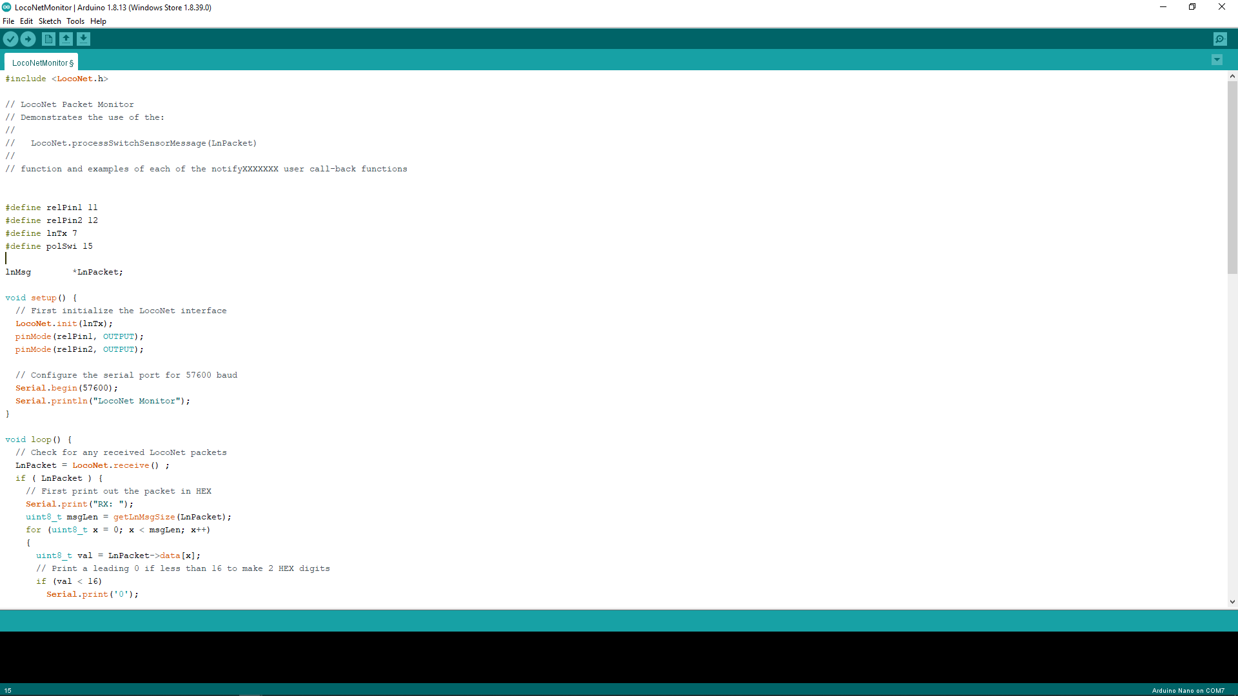

Slide 40
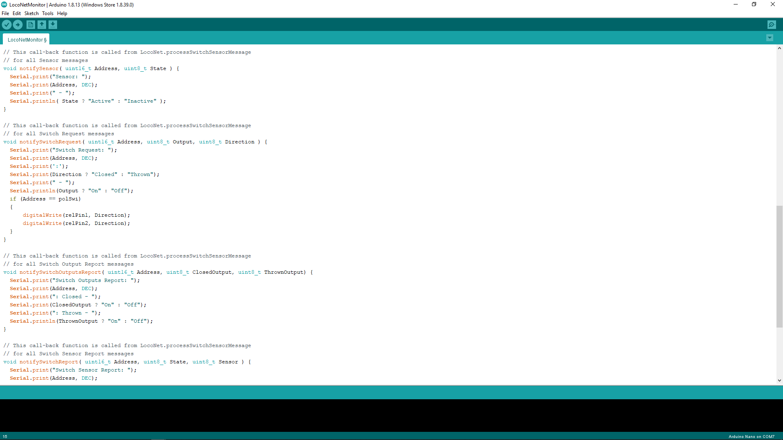

Slide 41
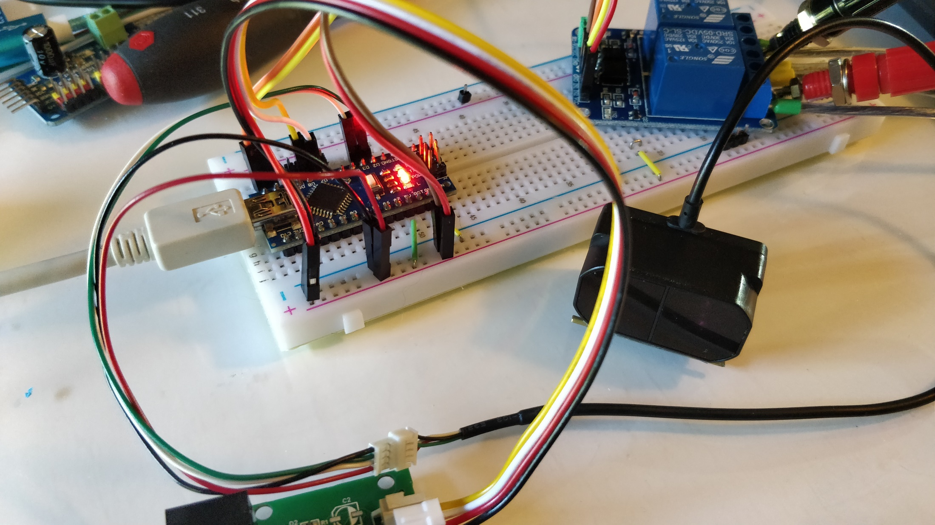
TF Mini Plus connected to IO pins 2&3 of the Nano

Slide 42
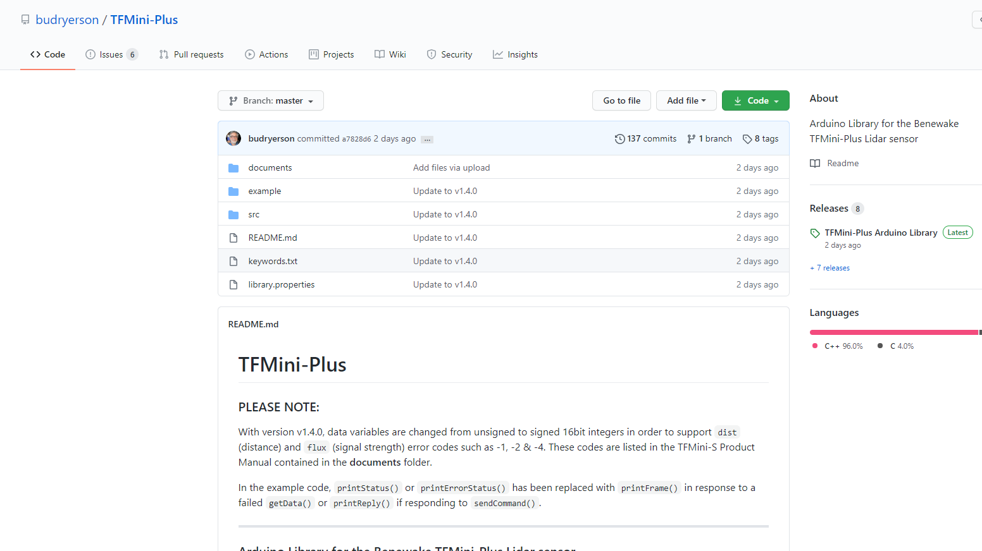

Slide 43
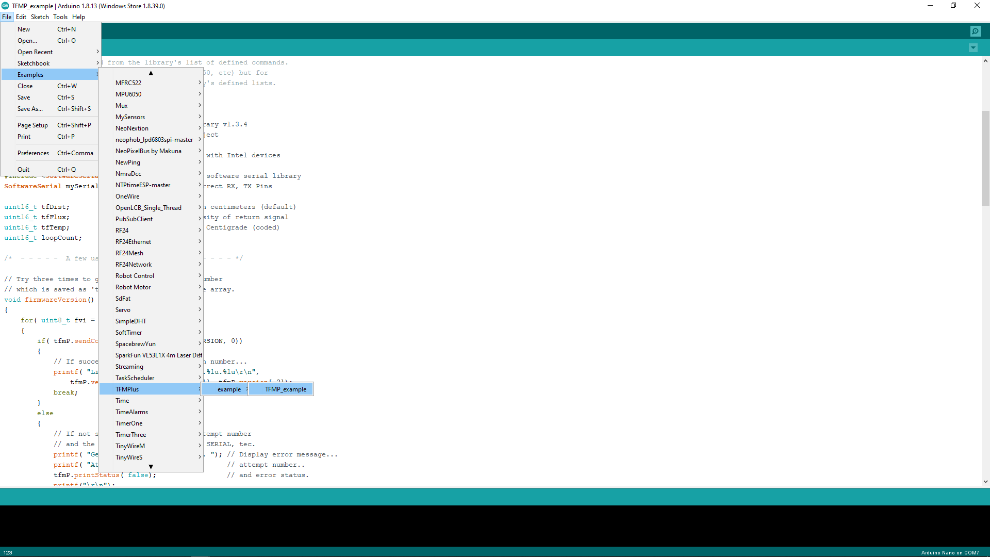

Slide 44
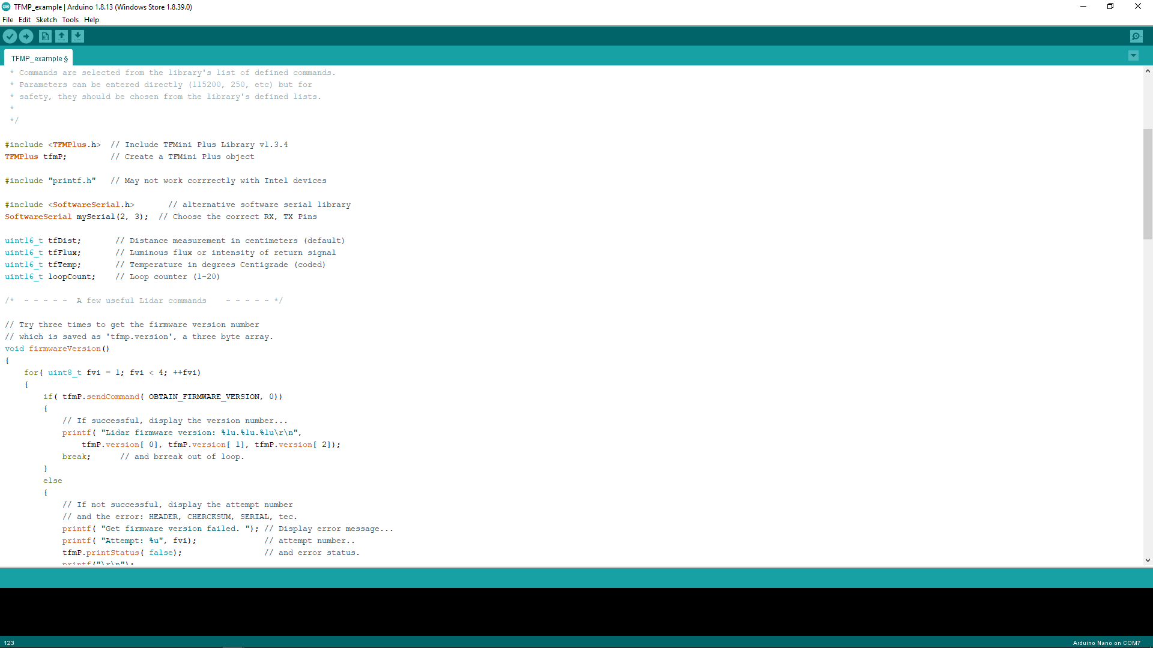

Slide 45
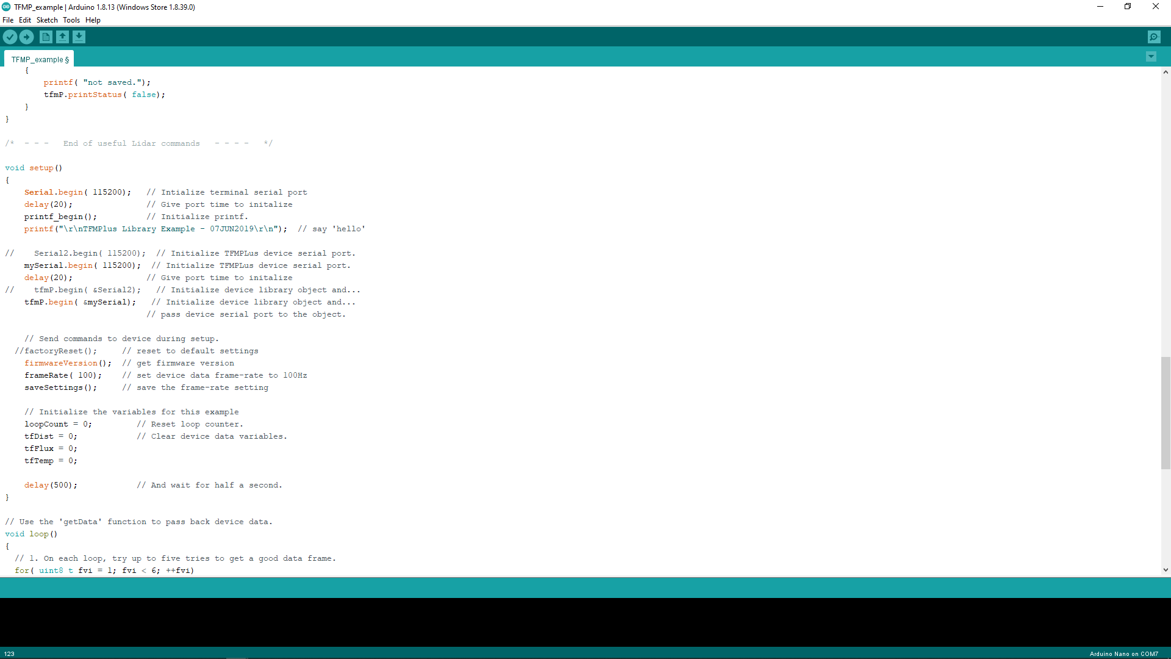

Slide 46
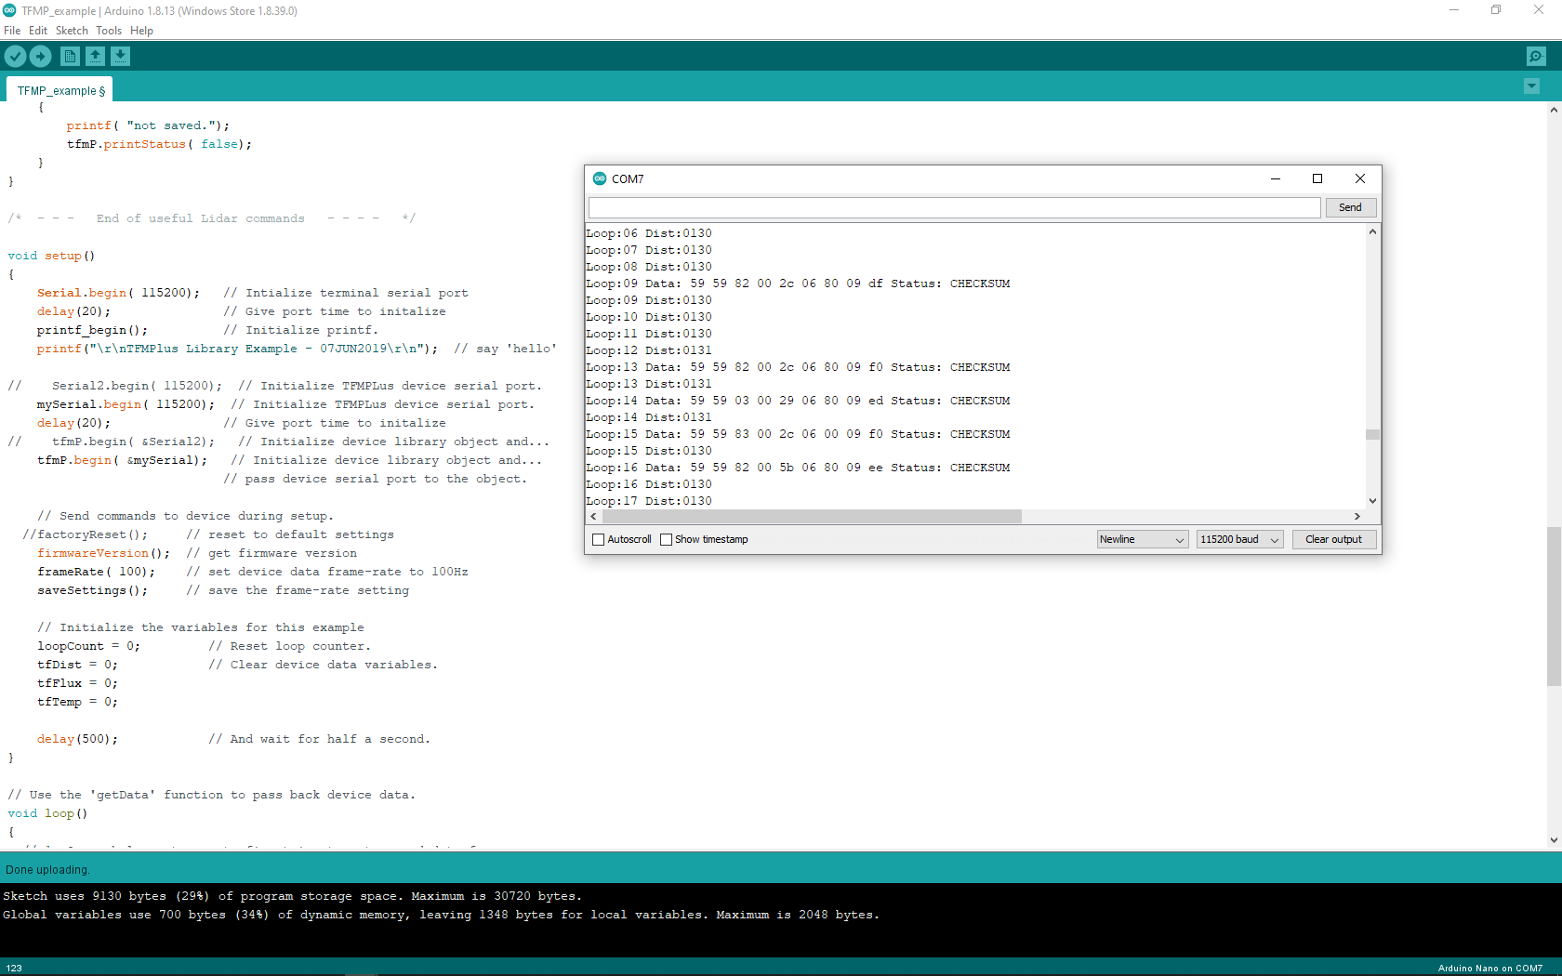

Slide 47
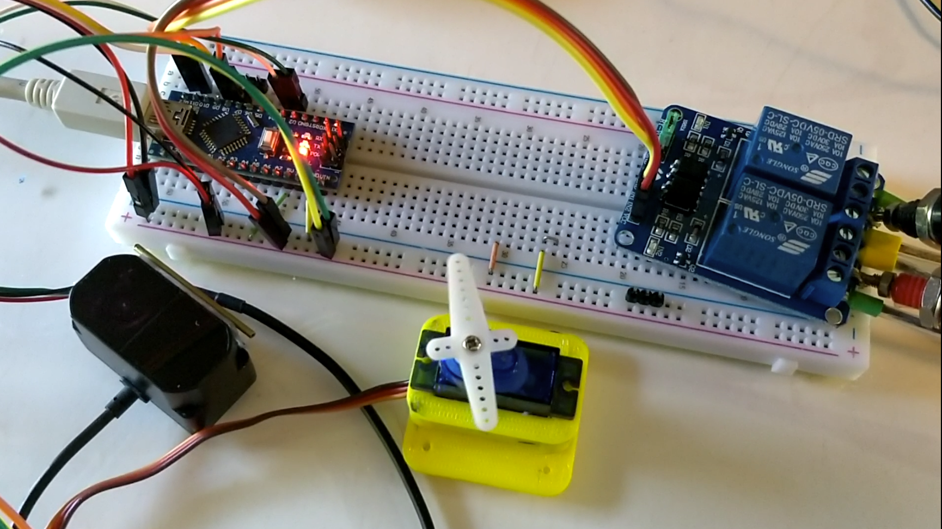
Servo connected to IO pin 9 of the Nano

Slide 48
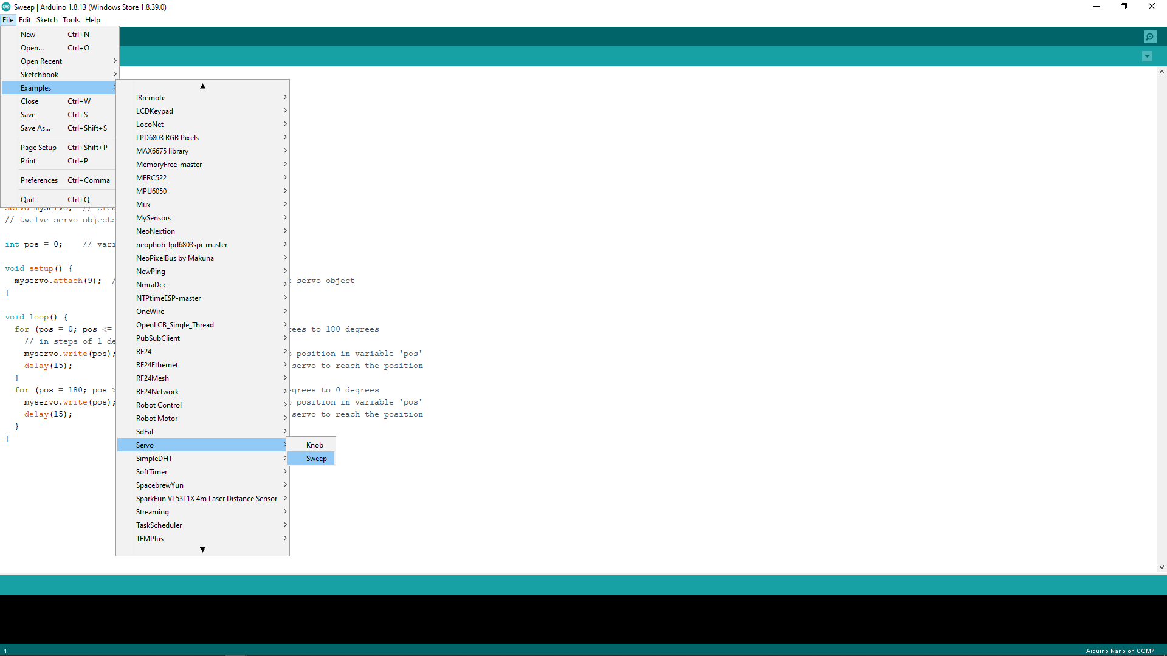

Slide 49
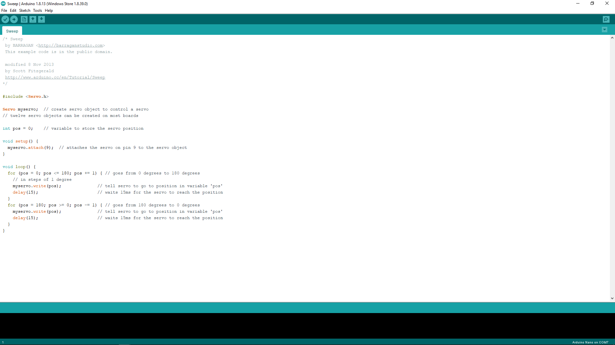

Slide 50
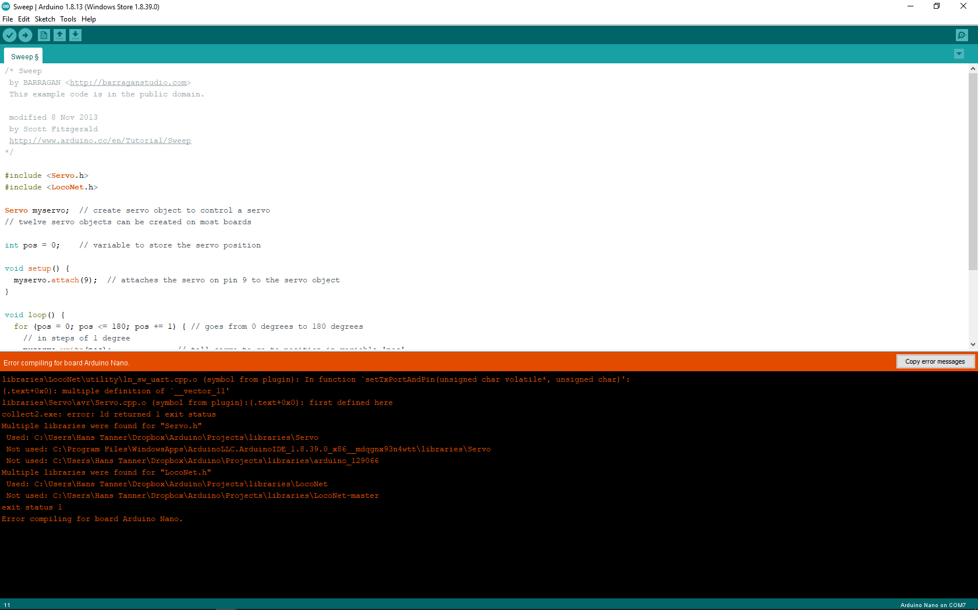
Servo.h and LocoNet.h are not compatible. Compiling generates a lot of errors.

Slide 51
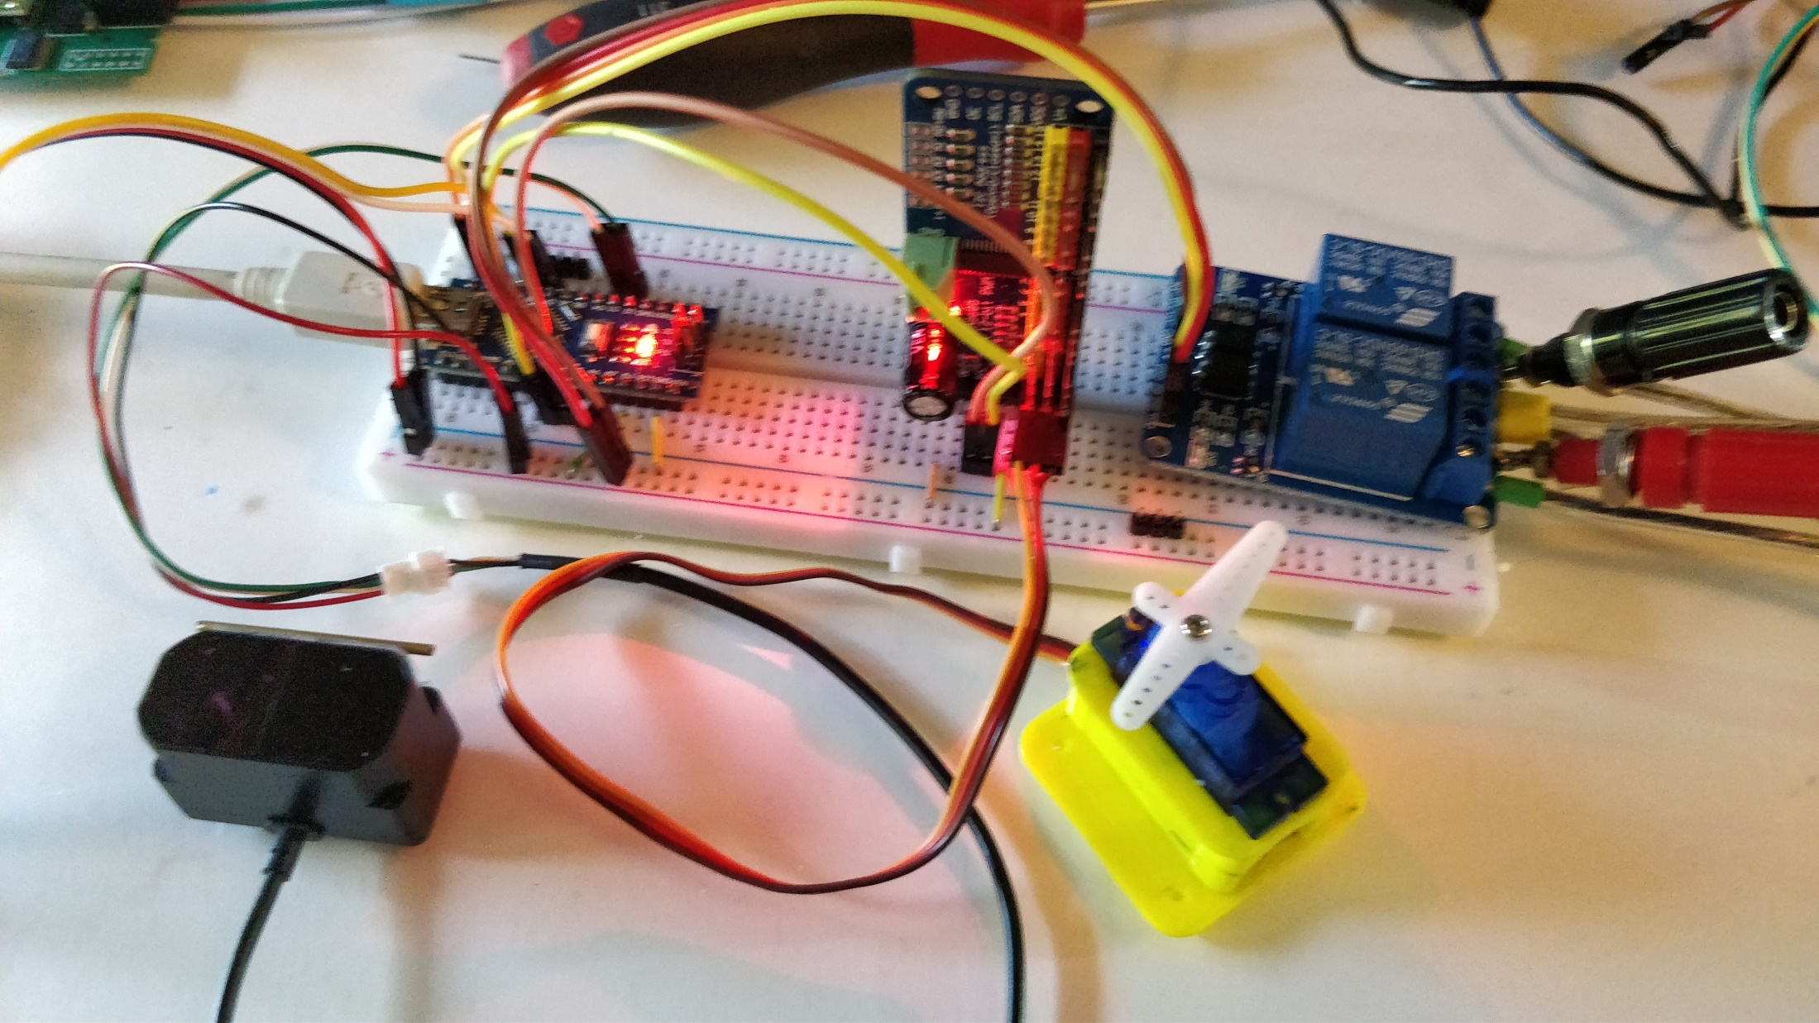
PCA9685 module connected to analog pins 4 & 5 of the Nano, Servo connected to PCA9685 Port 0

Slide 52
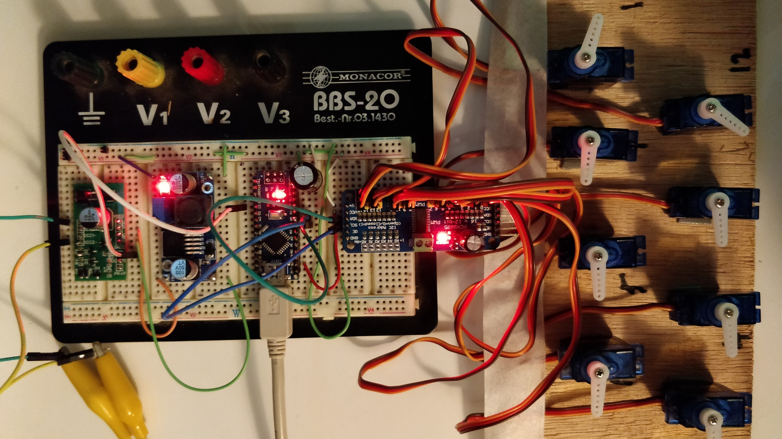
DIY DCC
16 Channel
Servo Decoder

Slide 53
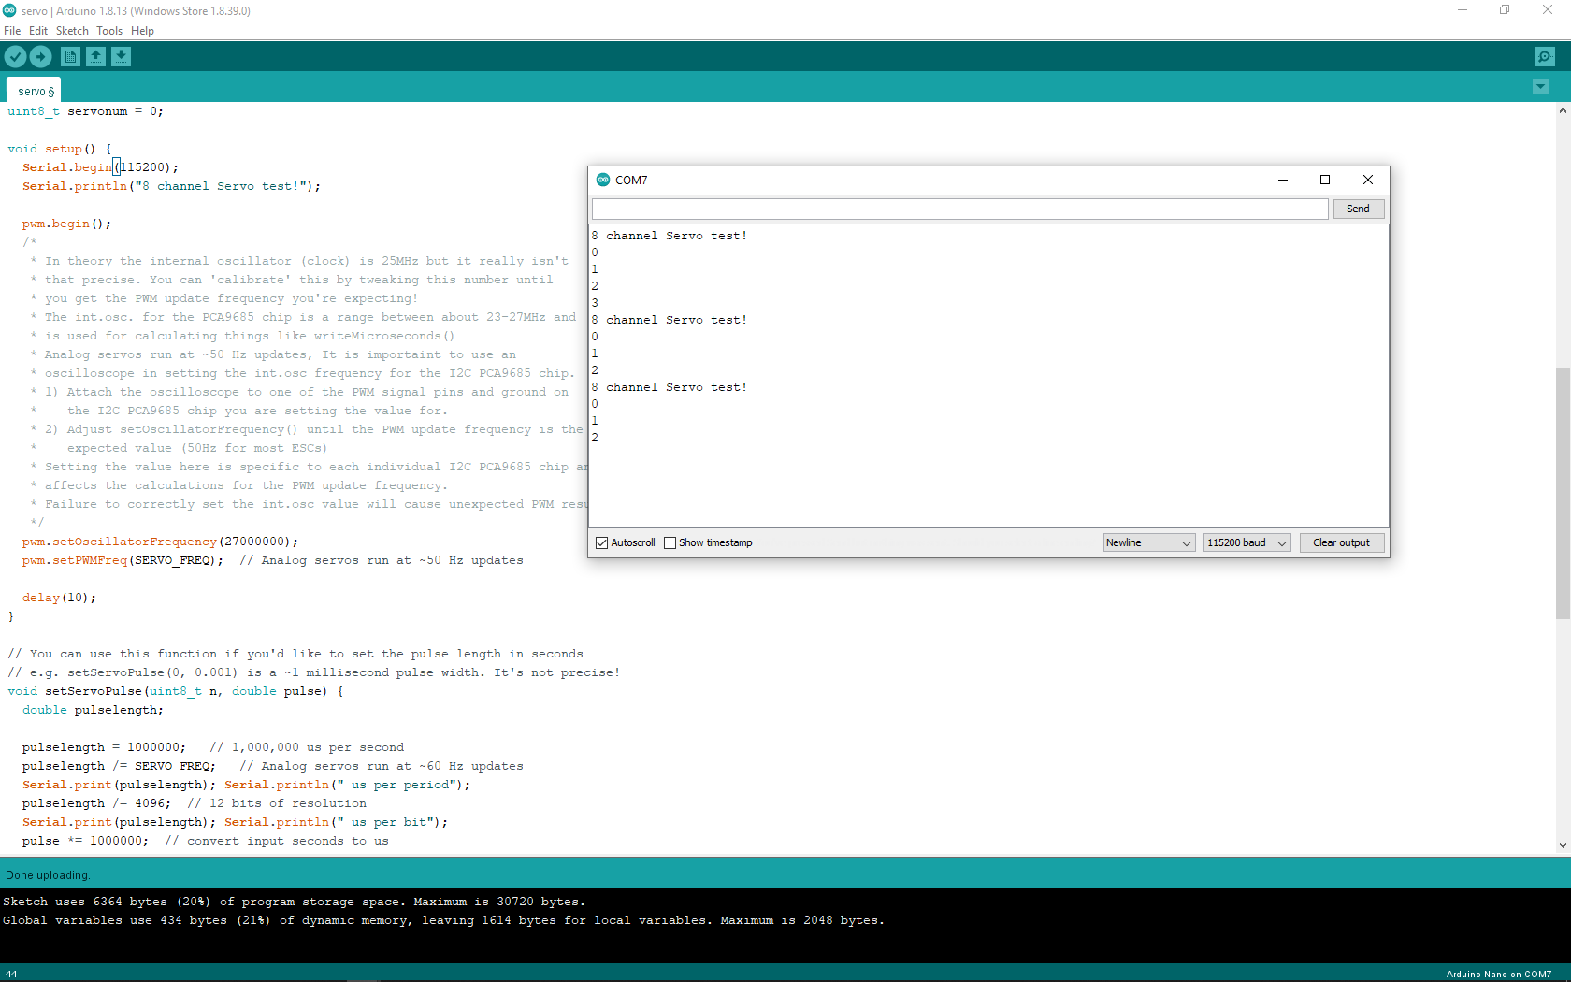

Slide 54
Shay
Track 1 Detection
Track 1
Sensor
Track 2 Detection
Track 2
Heisler
Potential viewing field of sensor at this position when it turns up to 180°
Potentially critical area: A train in this section might become invisible as it is behind another train located closer to the sensor

Slide 55
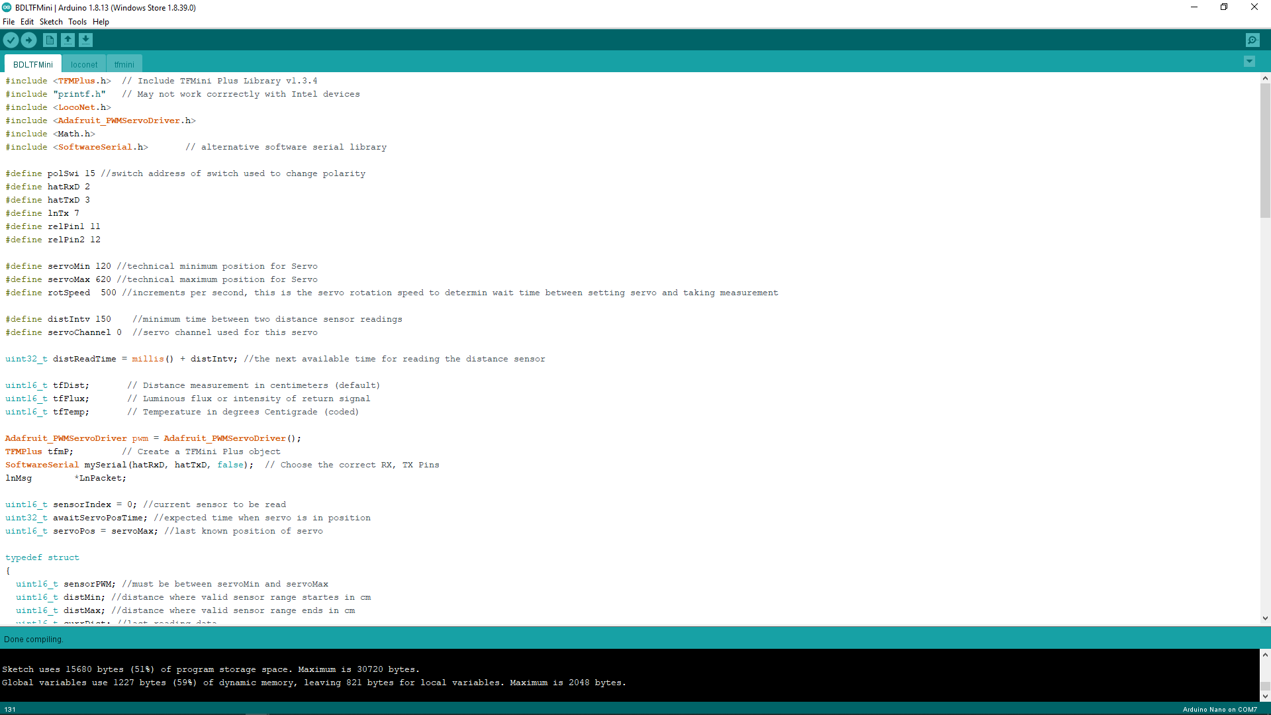

Slide 57
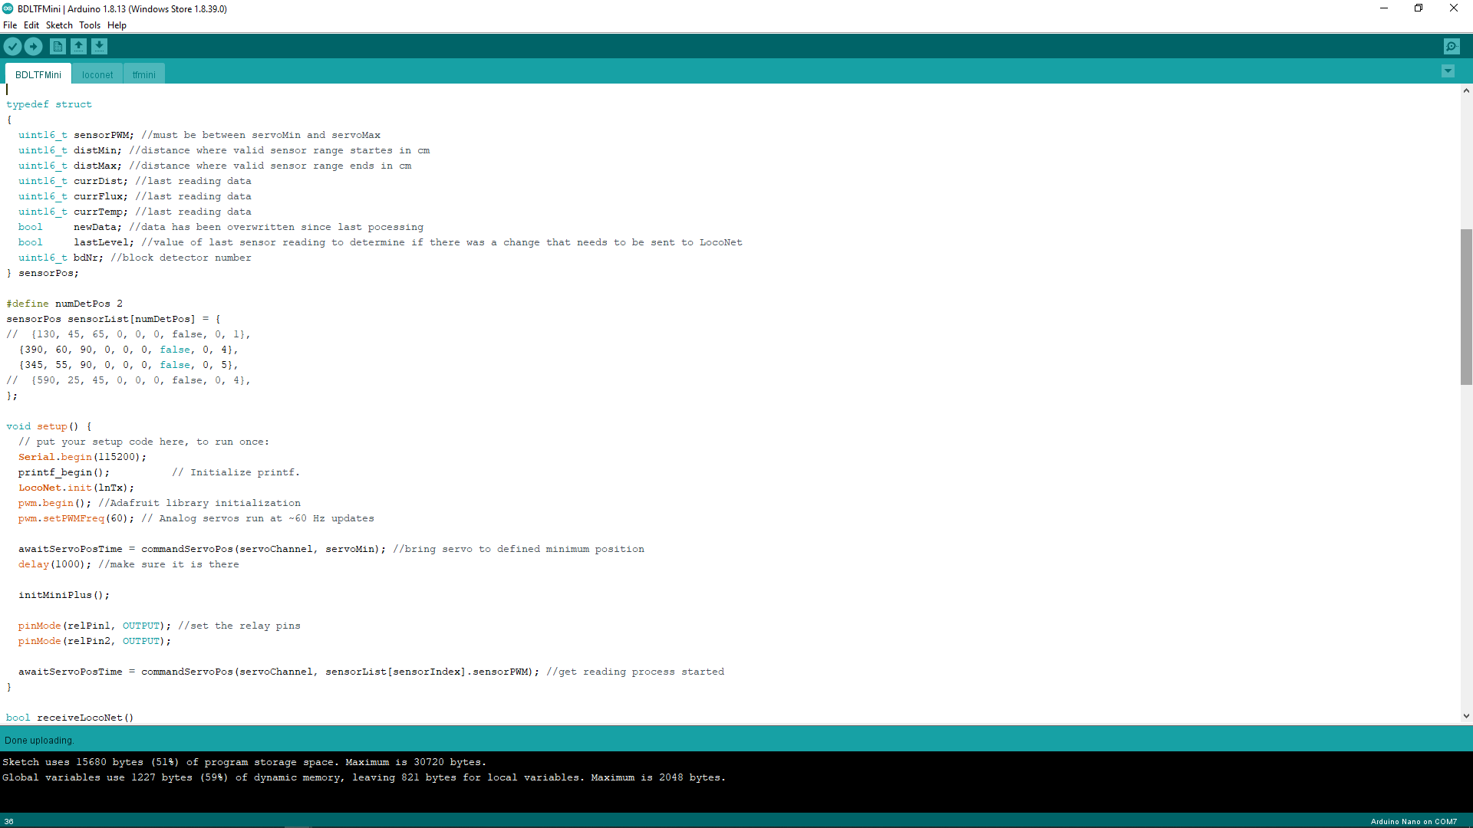

Slide 59
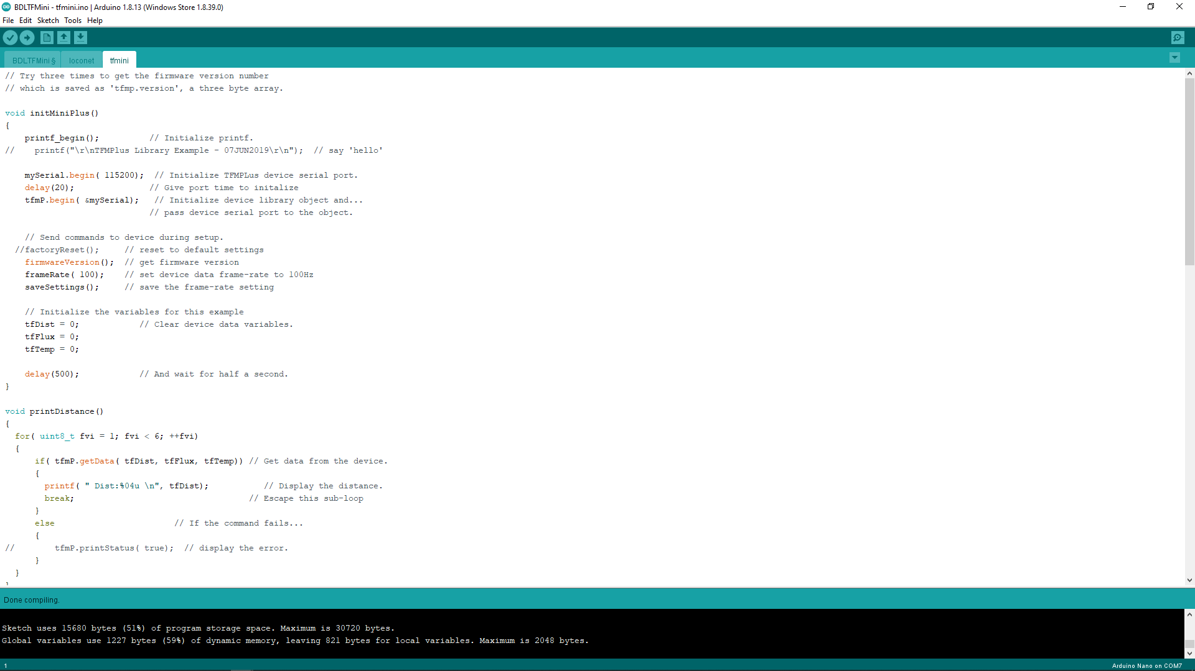

Slide 60
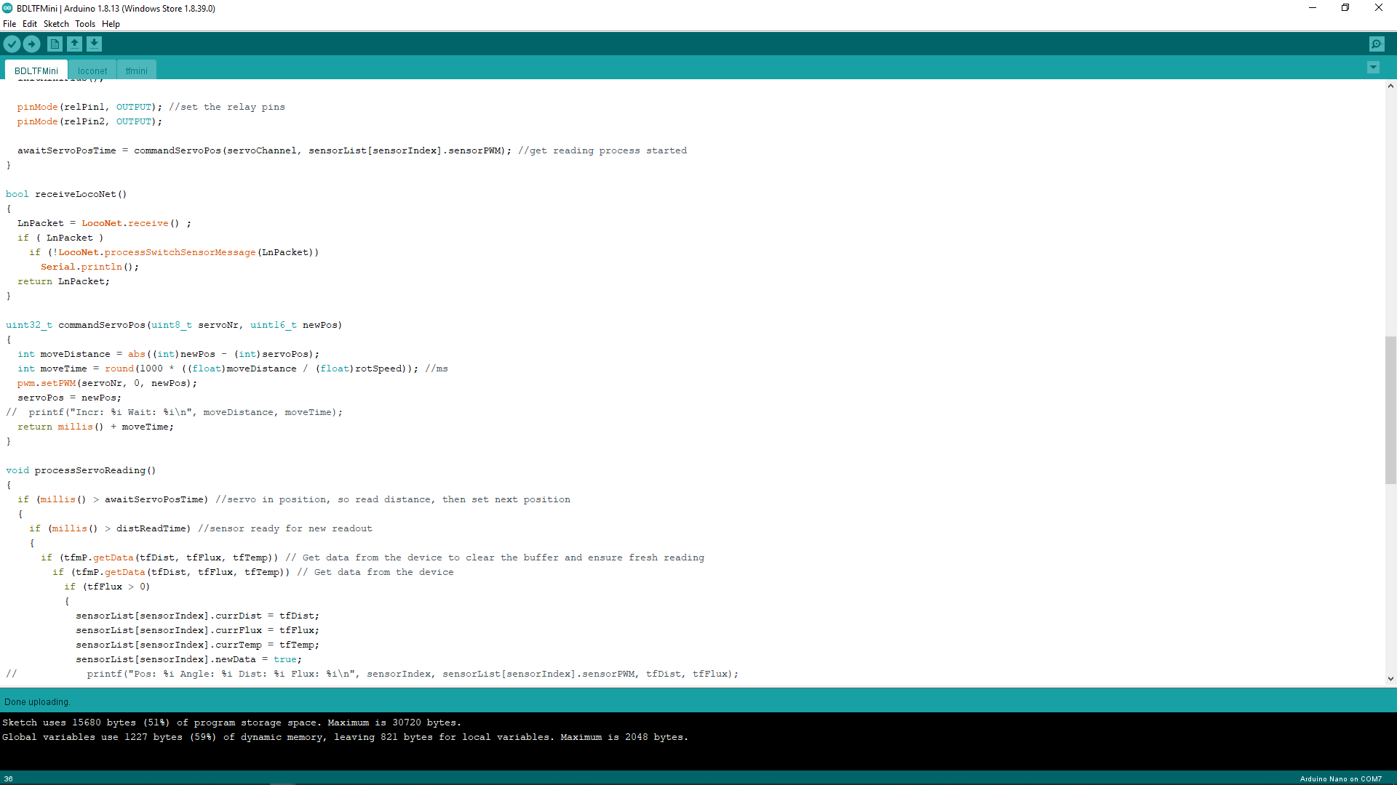

Slide 61
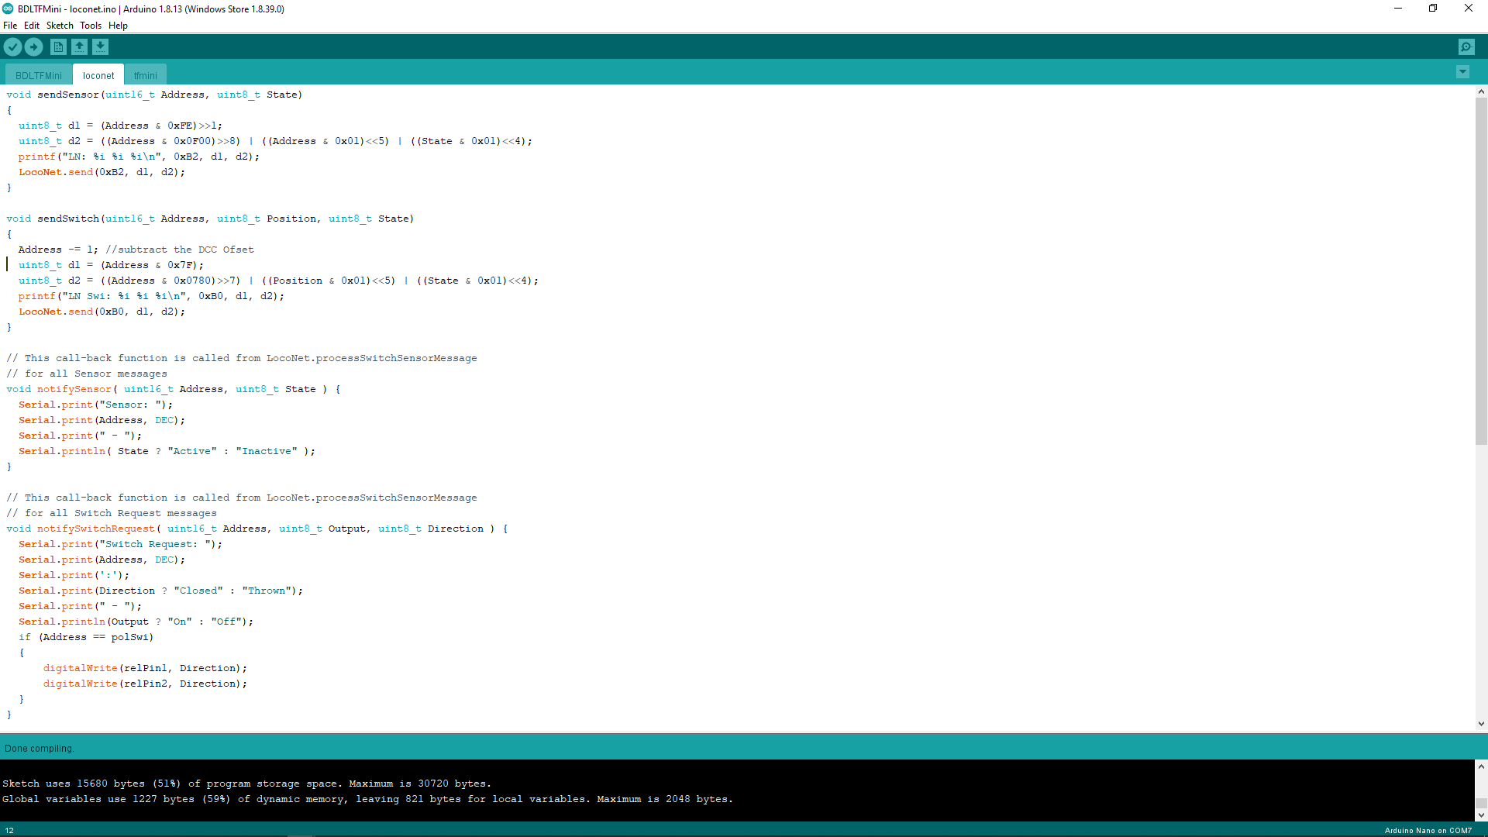

Slide 64
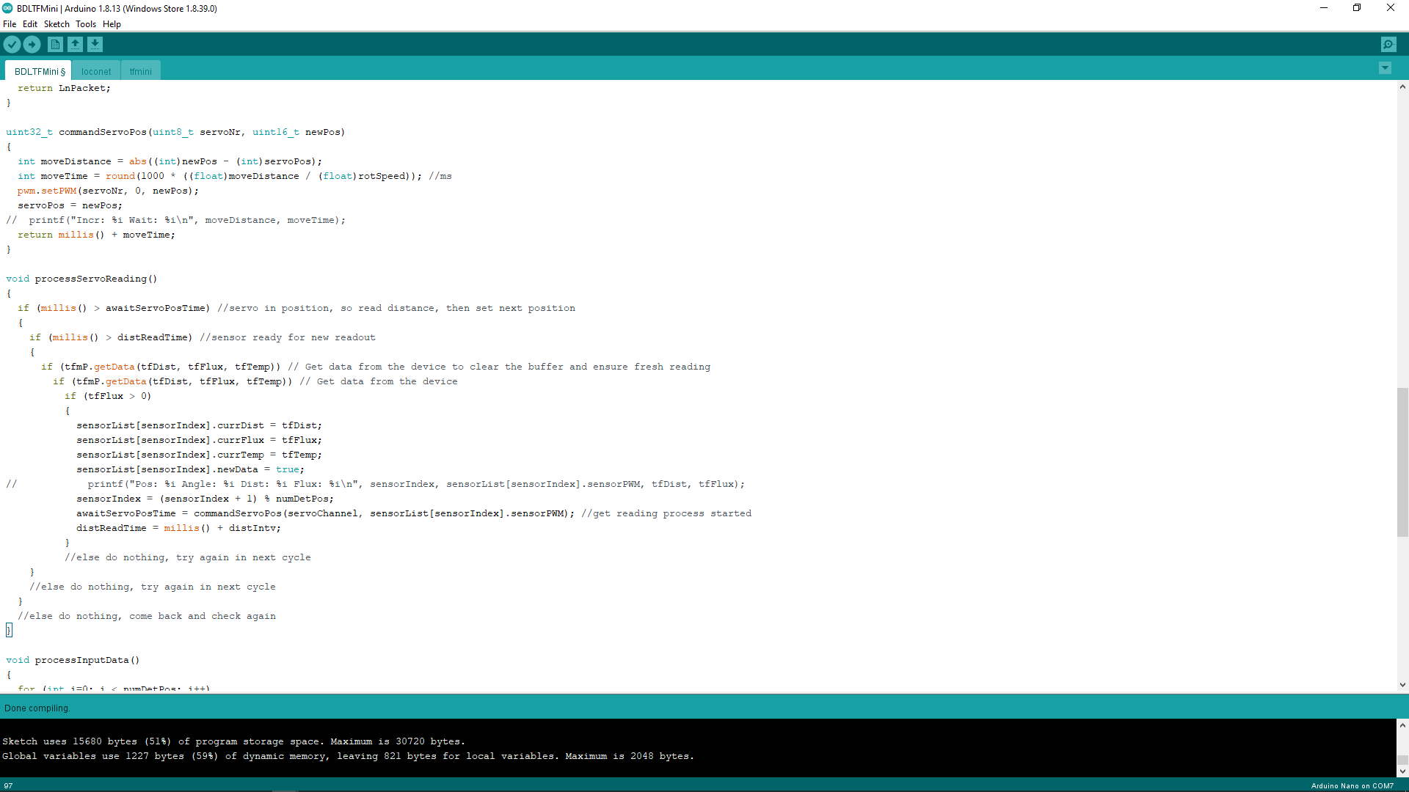

Slide 65
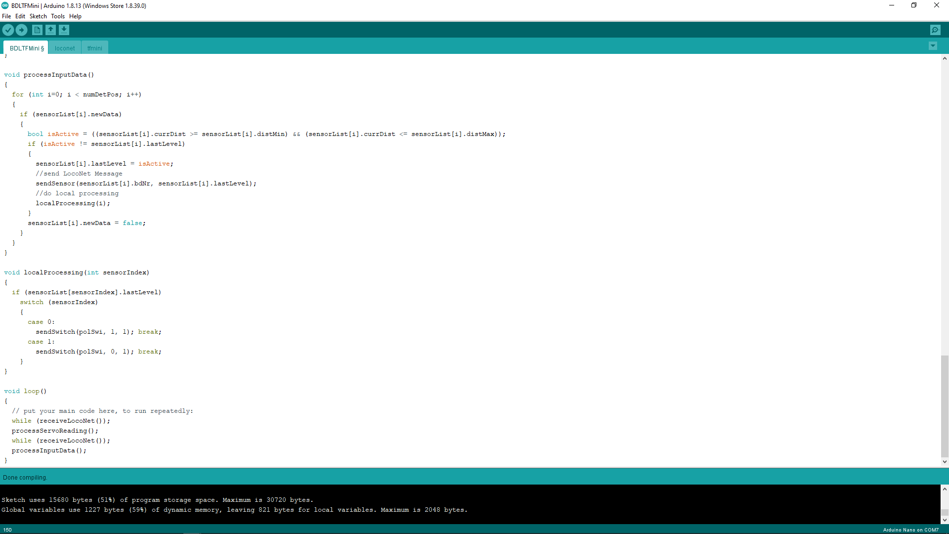

Slide 68
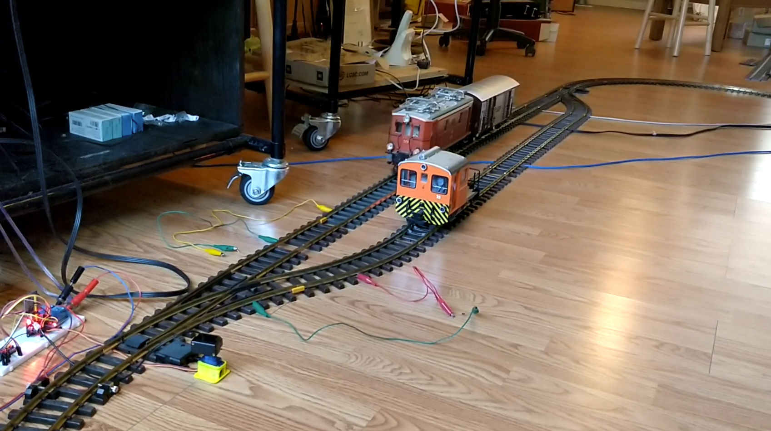


Shay
Heisler
Polarity Relay
Rail Isolation
Diode (!)
Lidar Sensor

Slide 69
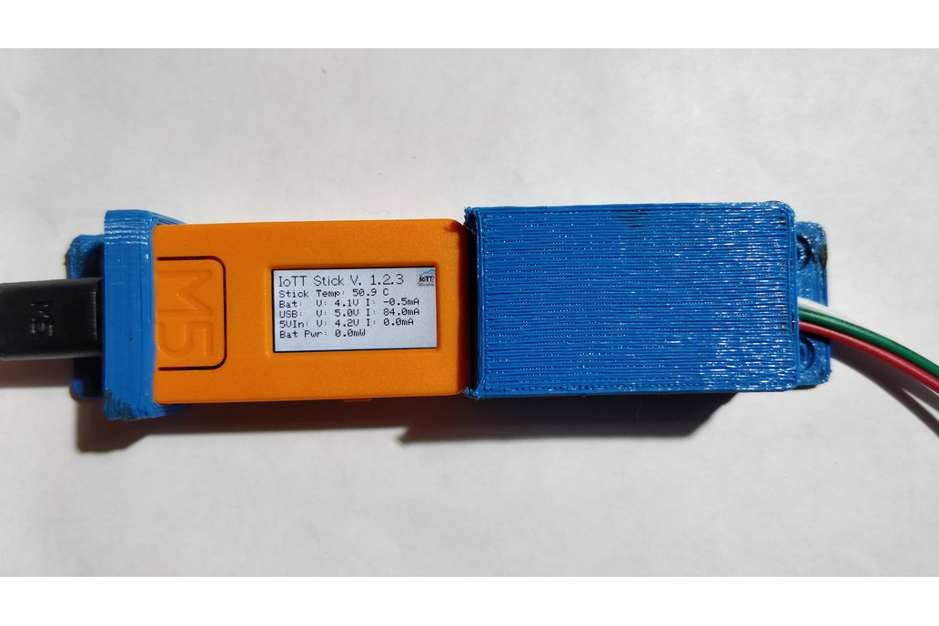



Slide 70


Slide 71


Slide 72
Shay
Track 1 Detection
Track 1
Sensor
Track 2 Detection
Track 2
Heisler
Approaching Heisler blocks viewing field of Track 1 sensor, therefore the Shay becomes temporarily invisible
Potentially critical area: A train in this section might become invisible as it is behind another train located closer to the sensor

Slide 73
Locomotive only crossing half of the cone leads to long reading
Sensor Detection Area (Active Cone)
Sensor

Slide 74
Locomotive crossing entire cone, reading is precise
Sensor Detection Area (Active Cone)
Sensor

Slide 75
Gear problems after 2+ hours of continuous operation

Slide 77
57
49 |  | 51 |  |  | 54
41 | 42 | 43 |  |  | 46 | 47
33
25
17 | 18 | 19 |  |  | 22 | 23
9 |  | 11 |  |  | 14
1

Slide 78
Summary

Slide 79
Summary
A simple layout animation for two trains can easily be done using DC power, a relay and two “At Point” detectors to change the polarity

Slide 80
Summary
A simple layout animation for two trains can easily be done using DC power, a relay and two “At Point” detectors to change the polarity
The suggested layout with a siding and two trains traveling in opposing directions seems simple but is complex enough to demonstrate more elaborated control concepts using DCC and JMRI scripting

Slide 81
Summary
A simple layout animation for two trains can easily be done using DC power, a relay and two “At Point” detectors to change the polarity
The suggested layout with a siding and two trains traveling in opposing directions seems simple but is complex enough to demonstrate more elaborated control concepts using DCC and JMRI scripting
By using a Lidar sensor mounted on a servo it is possible to create a software defined universal occupancy sensor, at least for G scale, but I think it also would work for HO

Slide 82
Summary
A simple layout animation for two trains can easily be done using DC power, a relay and two “At Point” detectors to change the polarity
The suggested layout with a siding and two trains traveling in opposing directions seems simple but is complex enough to demonstrate more elaborated control concepts using DCC and JMRI scripting
By using a Lidar sensor mounted on a servo it is possible to create a software defined universal occupancy sensor, at least for G scale, but I think it also would work for HO
With just two sensor locations, the readout frequency for each position is more than needed for train control. With more positions and wider angle there will be a slowdown.

Slide 83
Summary
A simple layout animation for two trains can easily be done using DC power, a relay and two “At Point” detectors to change the polarity
The suggested layout with a siding and two trains traveling in opposing directions seems simple but is complex enough to demonstrate more elaborated control concepts using DCC and JMRI scripting
By using a Lidar sensor mounted on a servo it is possible to create a software defined universal occupancy sensor, at least for G scale, but I think it also would work for HO
With just two sensor locations, the readout frequency for each position is more than needed for train control. With more positions and wider angle there will be a slowdown.
Those cheap SG90 servos are not made for continuous operation. A higher quality drive train is needed to prevent frequent mechanical failure

Slide 84
Tindie shop IoTT page: https://www.tindie.com/stores/tanner87661/
IoTT main page: https://myiott.org/
Github page for TF Mini plus library for Arduino: https://github.com/budryerson/TFMini-Plus
TF Mini plus: https://www.sparkfun.com/products/15179

Slide 85

if (watching_this(video) == (useful || interesting))
{
please_click_like();
subscribe_channel():
hit_the_bell_icon();
leave_a_comment();
}

Slide 86
if (watching_this(video) == (useful || interesting))
{
please_click_like();
}

Slide 87




IoTT
Internet of Toy Trains

